Slide 1
SME Academy
May 10th 2017
Chisinau, Republic of Moldova
Project secretariat: EUROCHAMBRES in cooperation with UEAPME

Slide 2
EU regulations and technical standards for agricultural products and foodstuffs Part 1: Getting familiar with EU food laws by making use of a checklist (Overview of main EU food laws) Part 2: Useful information sources (websites, databases) Chisinau, May 10th 2017
Luc Van Looveren, Senior Advisor EU relations
Luc.vanlooveren@voka.be
Project secretariat: EUROCHAMBRES in cooperation with UEAPME

Slide 3
Part 1. Checklist: EU legislation for foodstuffs
Introduction: a checklist for servicing SMEs with identification of and compliance with EU food laws
Presentation of the checklist
I. Common organisation of agricultural markets in the EU
Technical requirements for producing and selling foodstuffs in the EU
Labelling requirements for producing or selling foodstuffs in the EU
IV. Packaging requirements
www.east-invest2.eu

Slide 4
Introduction A checklist on compliance with EU foodstuffs laws
Aim = to help companies to prepare for exporting to the EU and for implications related to DCFTAs (touching also producers selling locally)
Antwerp-Waasland CCI in Belgium worked out a detailed ‘acquis communautaire’ checklist for agricultural products and foodstuffs.
The checklist is a useful diagnostic tool to help structure an interview with an SME and to find out:
- which main “acquis” (= EU product) rules are relevant for the company concerned;
- which “acquis” rules are already known to / implemented by the company
This can be followed by the delivery of a feedback report with targeted info on relevant laws and info on a possible support via the DCFTA SME Facility.

Slide 5
Introduction A checklist on compliance with EU foodstuffs laws
Each question refers to one or more EU-Directives or Regulations. The checklist already offers the ref. nrs. of the EU laws (= allows efficient identification of legal info such as summaries or full texts of EU laws).
The checklist covers the most important “acquis” measures in the sector of agro-food products. A completed “acquis” checklist can be used as a starting document for editing a structured “acquis” (audit) report on relevant EU product laws.
Example: see next slide

Slide 6
Introduction A checklist on compliance with EU foodstuffs laws
Example:
Is your company producing or distributing quick-frozen foodstuffs?
(Dir. 89/108) Yes O No O
If yes, is the company aware of the EU rules in this field?
O No.
O Yes, my company knows the European legal rules in this field and disposes of the relevant legal texts.
My company is: O already implementing these rules
O did not yet start implementing these rules

Slide 7
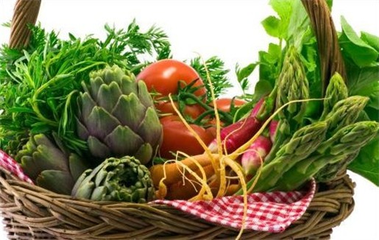
Checklist EU legislation for foodstuffs I. Common organisation of agricultural markets in the EU
I.1. Common market organisation for 21 sectors
I.1.1. Production / distibution of agricultural
products (Reg. 1308/2013)
Products covered:
cereals, rice, sugar, dried fodder, seeds, hops, olive oil and table olives, flax and hemp, fruit and vegetables, processed fruit and vegetables, bananas, wine, live plants and products of floriculture, raw tobacco, beef and veal, milk and milk products, pigmeat, sheepmeat and goatmeat, eggs, poultrymeat and other products.
Specific measures for:
ethyl alcohol of agricultural origin; apiculture products (natural honey, royal yelly and propolis, pollen beeswax); silkworms.
Import licenses, import tariffs, import tariff quotas, standards for marketing (for certain products)

Slide 8
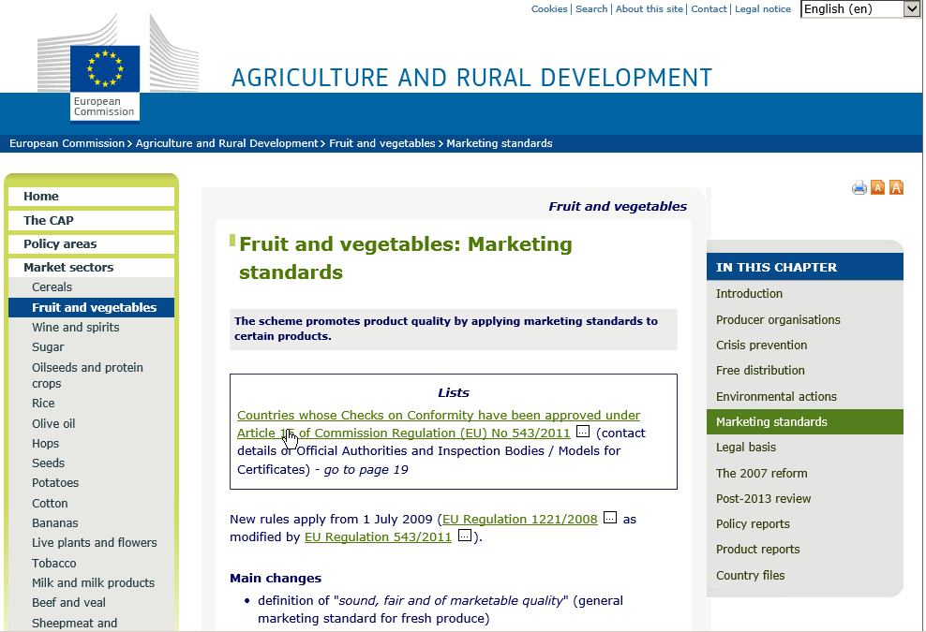
Consult info on marketing standards for agricultural products at:
http://ec.europa.eu/agriculture/fruit-and-vegetables/marketing-standards/index_en.htm

Slide 9
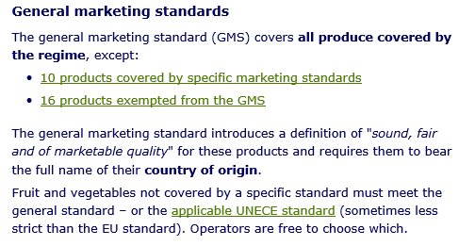

Slide 10
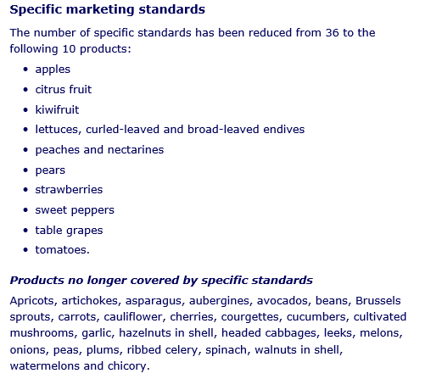

Slide 11
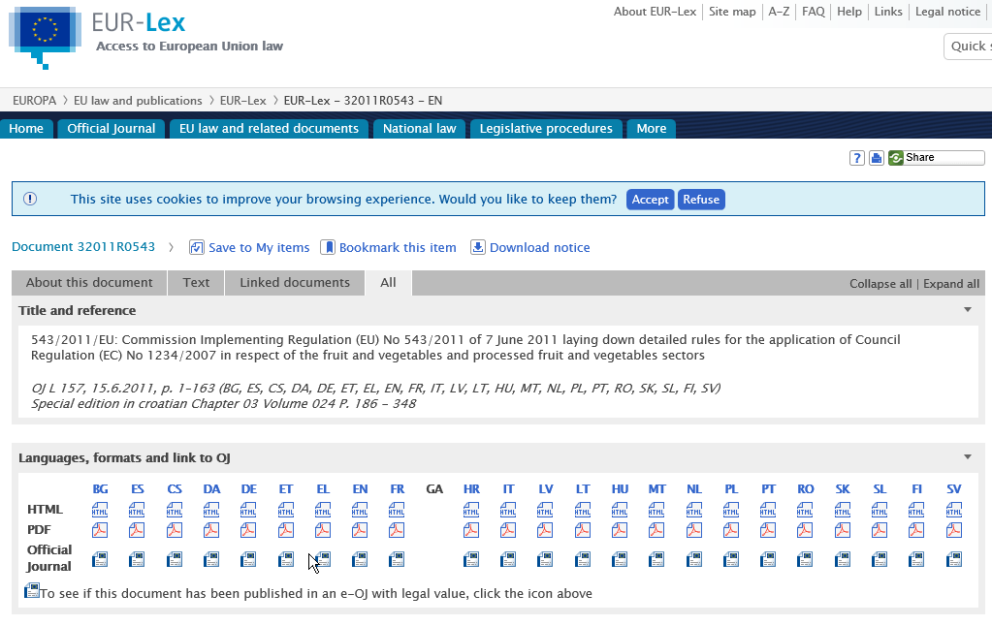
Eur-Lex allows to consult and download full texts of EU laws (see further in Part 2)

Slide 12
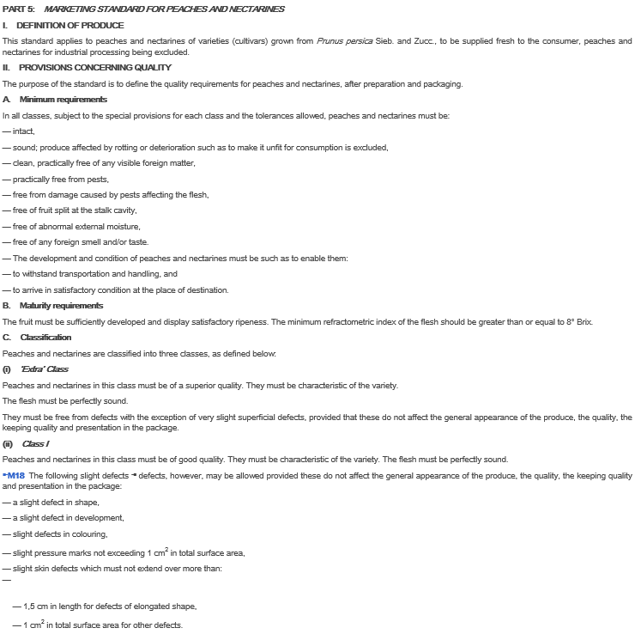
Illustration: some elements from a list with Marketing Standards
for peaches and nectarines

Slide 13
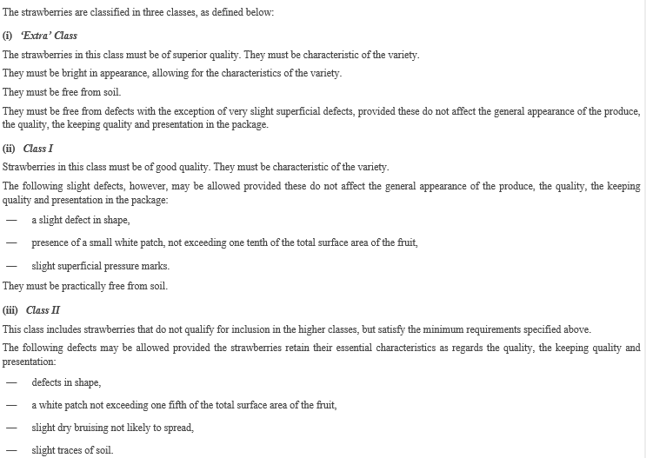
Marketing standards for strawberries (next slides: products not qualifying)

Slide 14
“ugly” strawberry

Slide 15
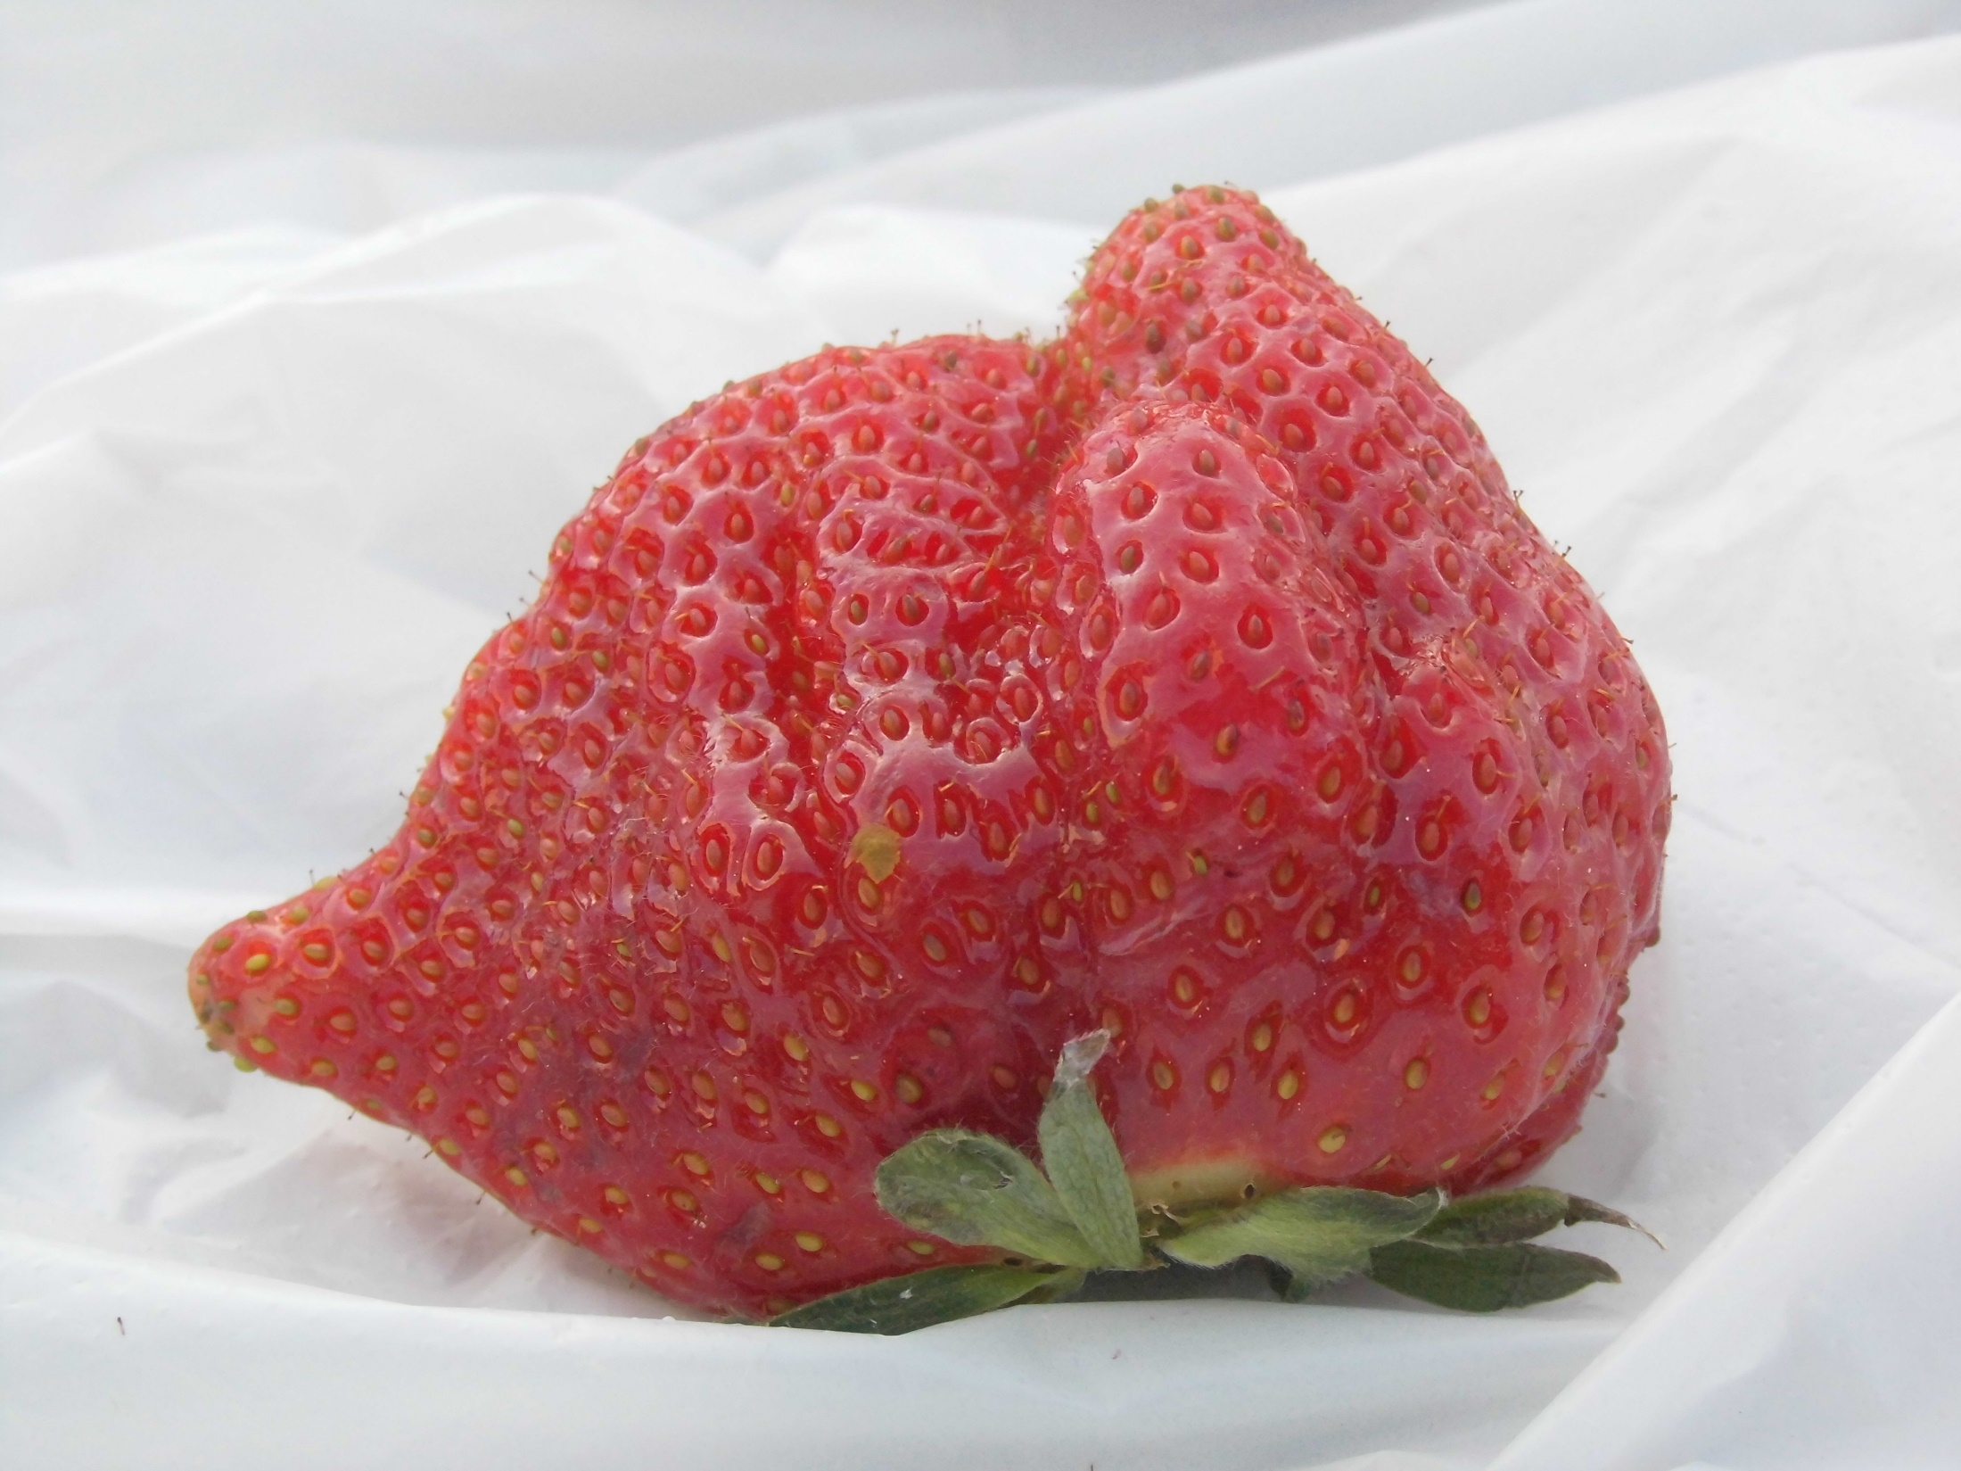
“ugly” strawberry

Slide 16
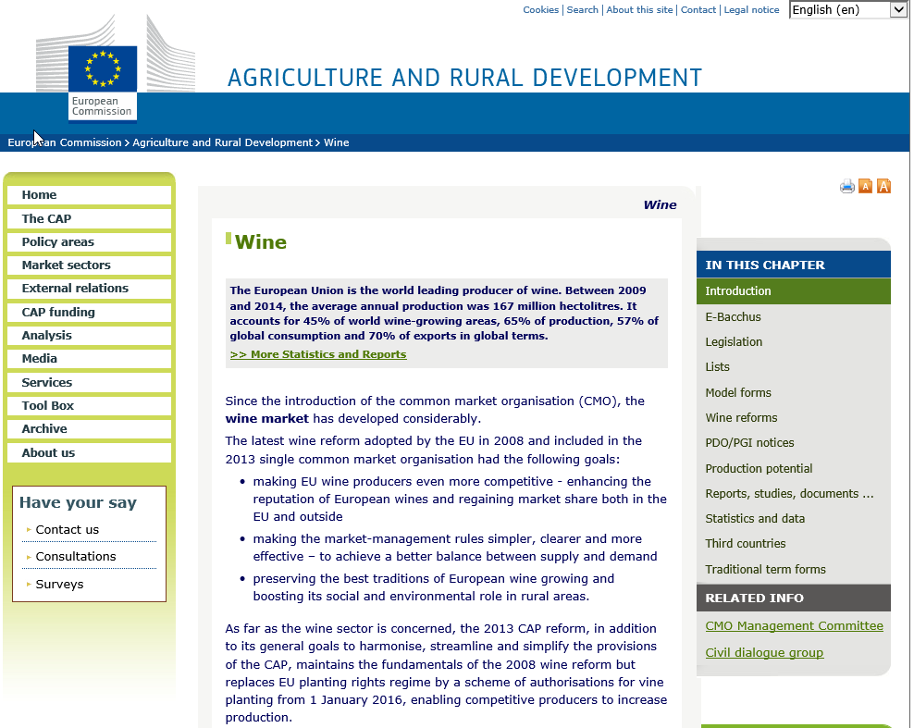

Slide 17
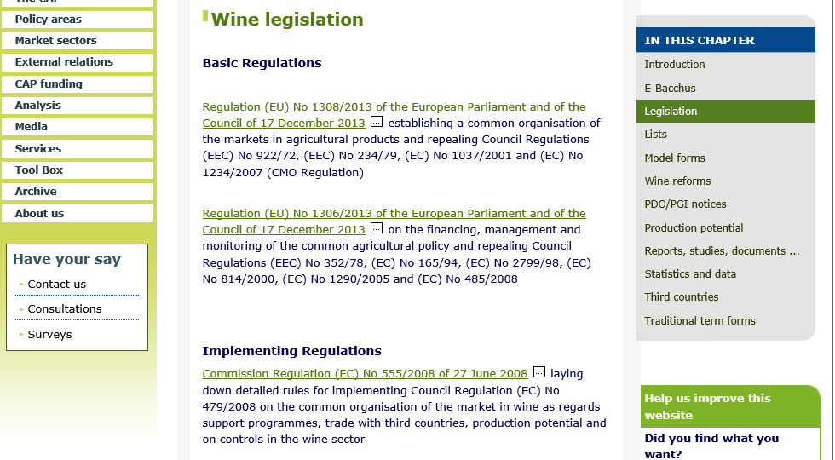
Read here more about export of wine to the EU

Slide 18
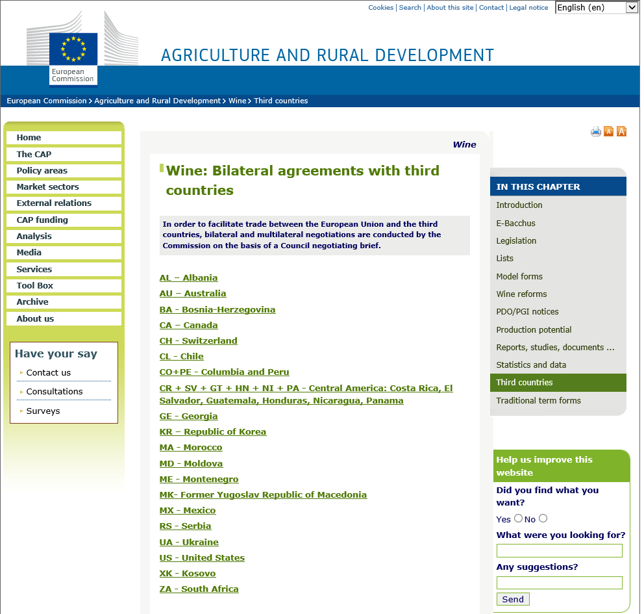
Consult here wine agreements between EU and Georgia, Moldova, Ukraine, …

Slide 19
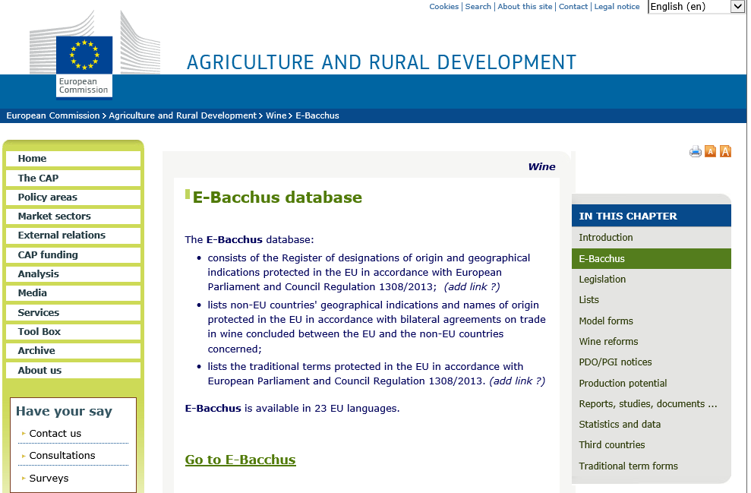

Slide 20
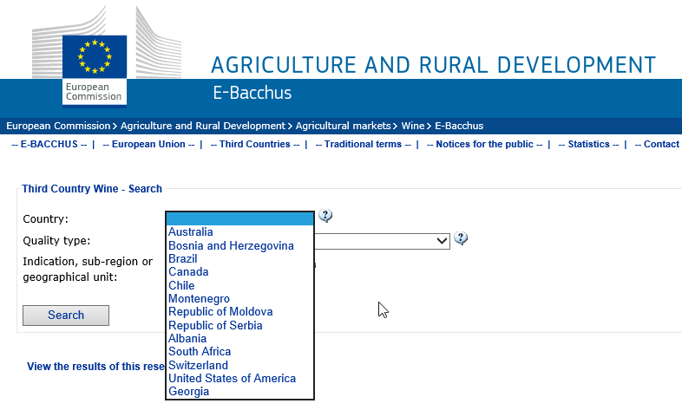

Slide 21
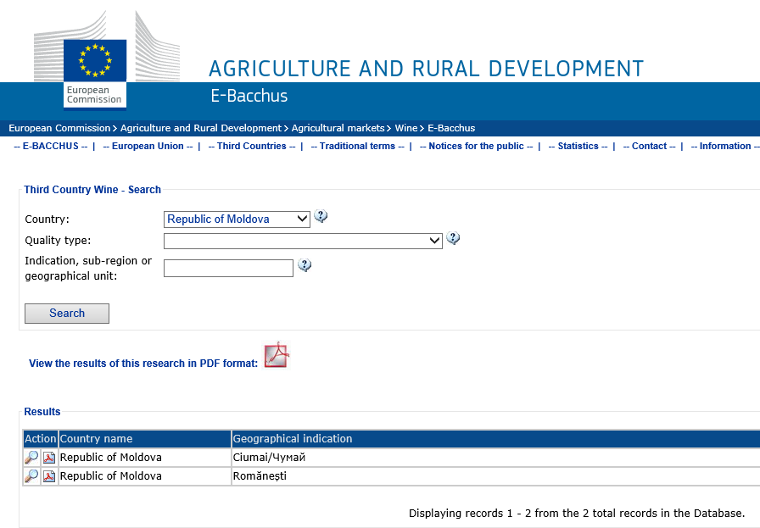
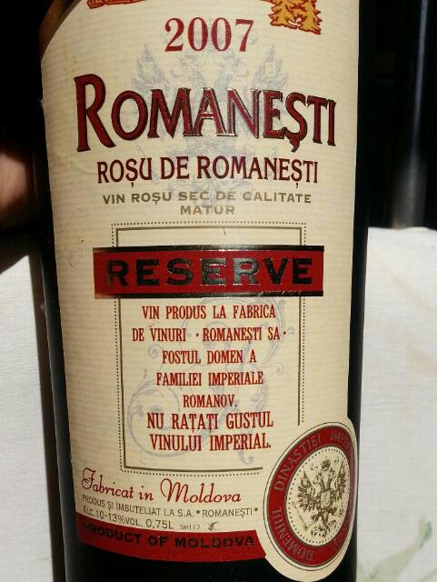

Slide 22
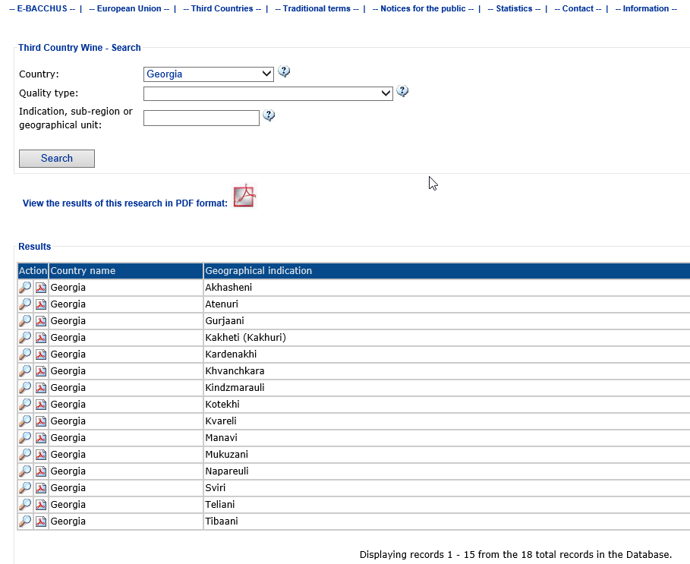
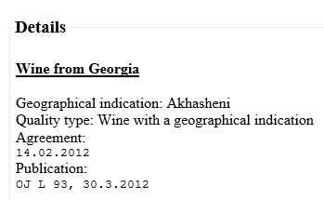
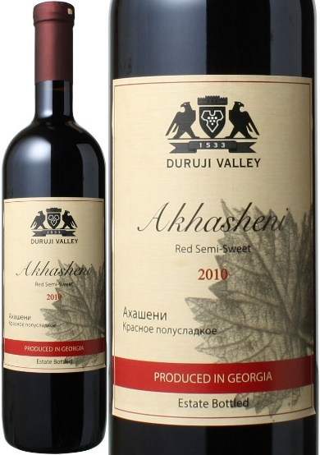
Click here and view details of protected geographical indications

Slide 23
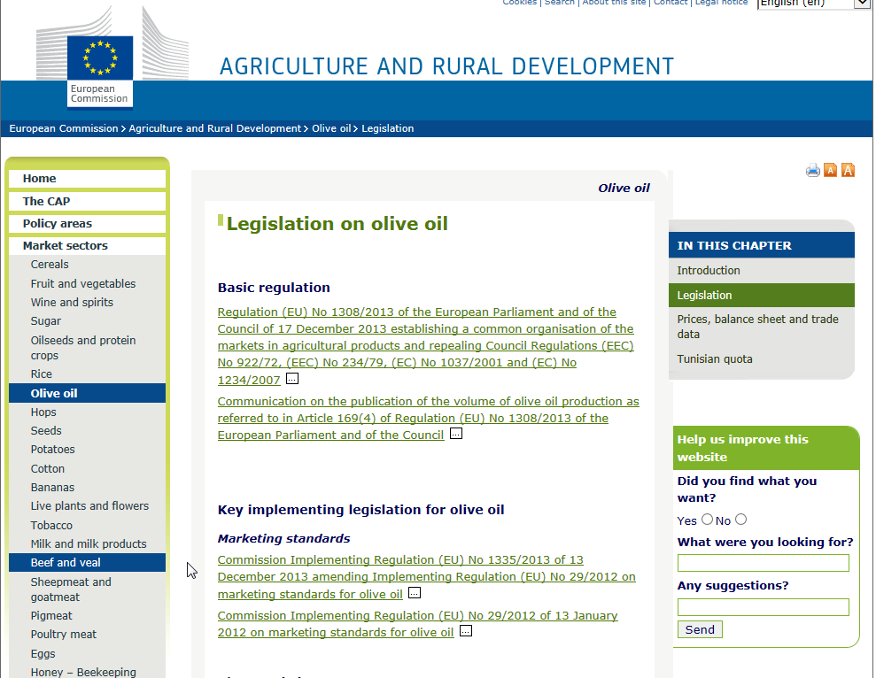
Consult here info on marketing standards for olive oil

Slide 24
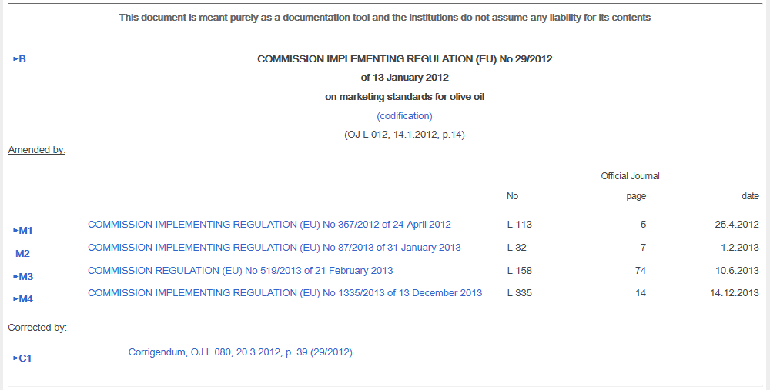

Slide 25
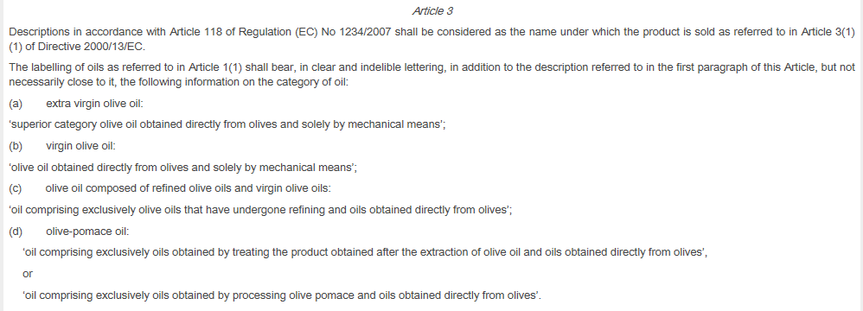
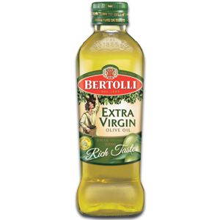
Example: labelling rules for olive oil (Reg. 29/2012) – categories of oil

Slide 26
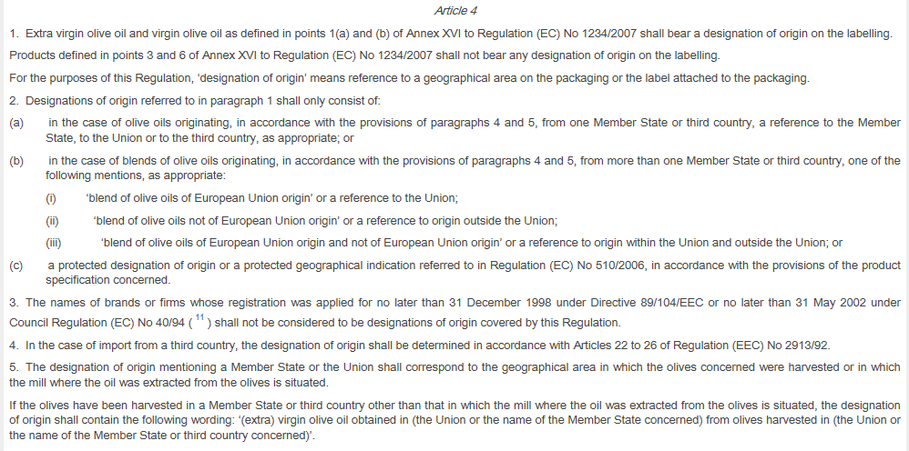
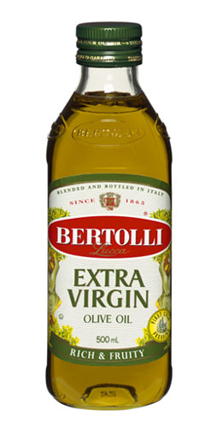
Example: labelling rules for olive oil (Reg. 29/2012) – designation of origin

Slide 27
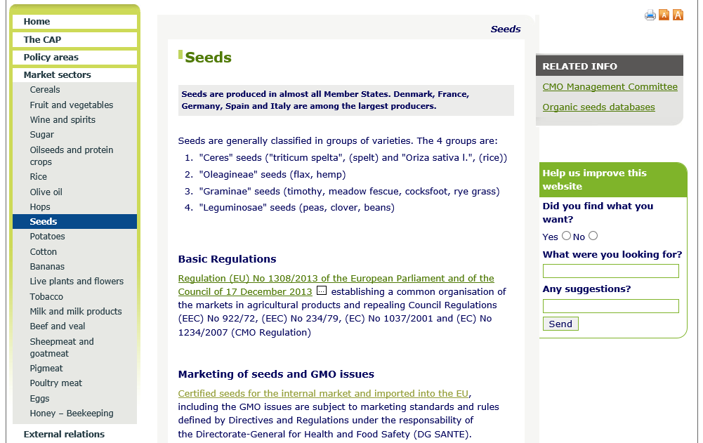
Read here more about importing seeds in the EU

Slide 28
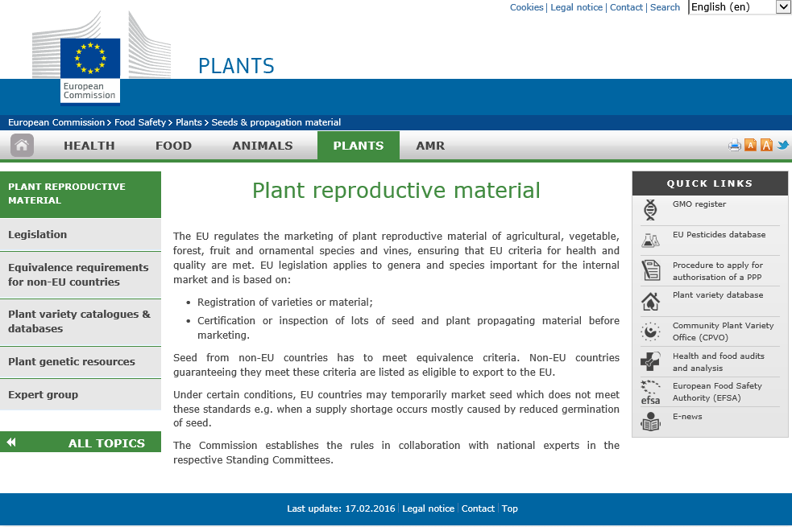
http://ec.europa.eu/food/plant/plant_propagation_material/index_en.htm
Seeds need to correspond with health and quality criteria

Slide 29
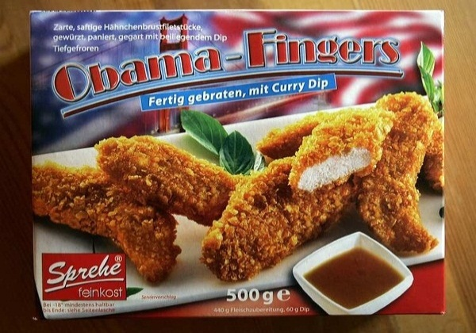
Checklist EU legislation for foodstuffs II. Technical requirements
II.1. Production methods
II.1.1. Quick-frozen foodstuffs (Dir. 89/108/EEC)
In principle: - 18° or lower
(Deviations allowed: transport / local distribution / retail cabinets)
Only air, nitrogen and carbon dioxide as cryogenic media (purity criteria)
Labelling indications: ‘quick-frozen’ + clear message of the type ‘do not refreeze after defrosting’+ batch identification + period during which quick-frozen products may be stored by the purchaser and the storage temperature and/or type of storage equipment required must be indicated
+ packaged in pre-packaging which protects against microbial
or other forms of external contamination and drying

Slide 30
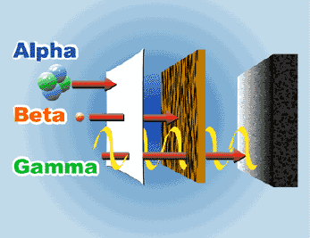
Checklist EU legislation for foodstuffs II. Technical requirements
II.1. Production methods
II.1.2. Ionising radiation treatment (Dir. 1999/2/EC and 1999/3/EC)
Conditions for authorizing food irradiation (technological need, benefit to the consumer, etc.) !Not replace hygiene measures
Sources of ionising radiation (gamma rays, x rays and electrons of certain characteristics)
Dosimetry (determination of the overall average absorbed dose + procedures for measuring it)
Labelling indications: “irradiated” or “treated with ionising radiation”
Import: documents with name + address of an approved irradiation facility

Slide 31
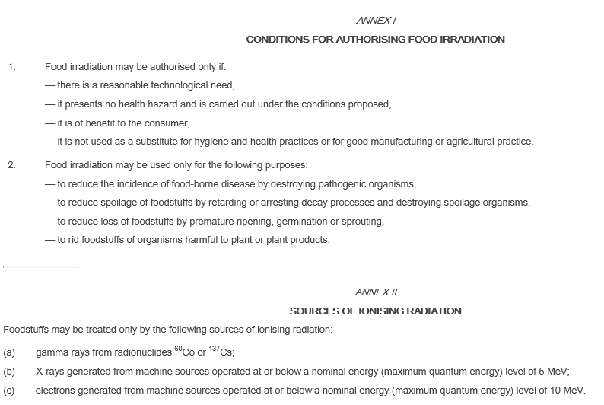

Slide 32
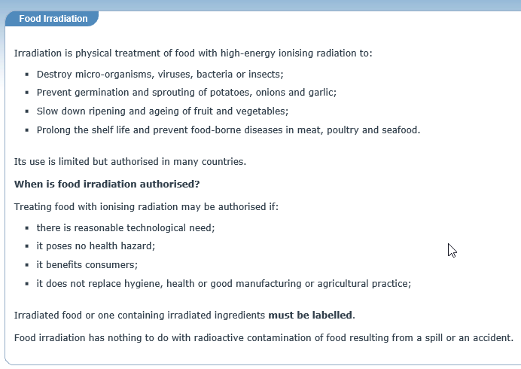
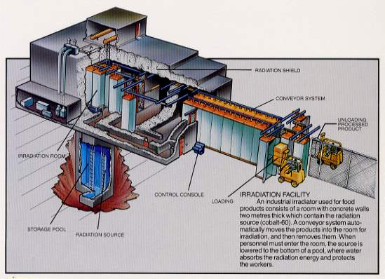

Slide 33
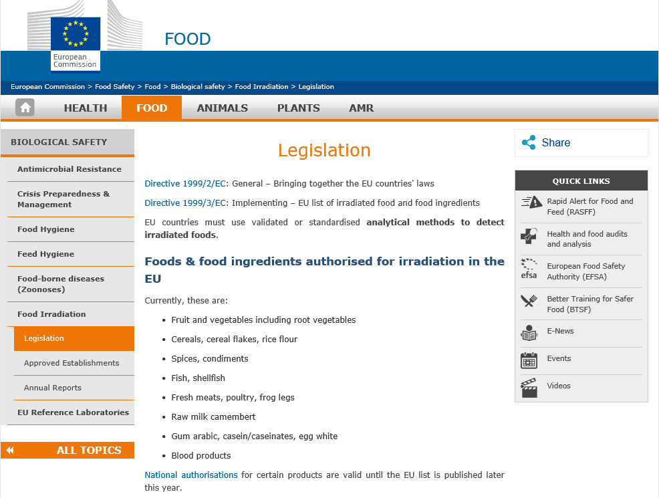
https://ec.europa.eu/food/safety/biosafety/irradiation_en
The European Commission has agreed a list of irradiated foods that can be freely traded across the European Union (EU). The list is not complete and at present it has only one food group: dried aromatic herbs, spices and vegetable seasonings. Until this list is complete, EU member states may continue to allow the irradiation of additional categories of foods.

Slide 34
Checklist EU legislation for foodstuffs II. Technical requirements
II.1. Production methods
II.1.3. Novel foods or novel food ingredients, Genetically Modified
Organisms (GMOs)
(Reg. 258/97, Reg. 1829/2003, Reg. 1830/2003, Dir. 2001/18/EC, Reg. 65/2004)
Novel foods can be newly developed, innovative food or food produced using new technologies and production processes as well as food traditionally eaten outside of the EU.
Authorization: 1) companies can apply to a Member State competent authority for authorization, presenting the scientific information and safety assessment report; or
2) use simplified notification procedure (= reference to substantially equivalent already authorized product)
Labelling: authorization of a novel food covers specification and labelling requirements (and conditions of use, designation of novel food or
novel food ingredient
! Reg. 258/97 (novel foods) will be replaced by Reg. (EU) 2283/2015 from 1/1/2018

Slide 35
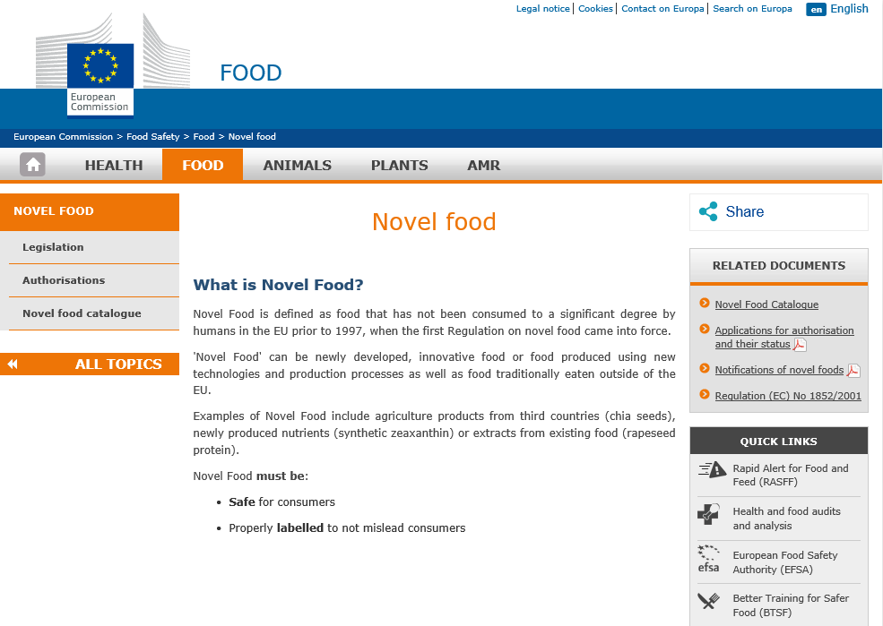
http://ec.europa.eu/food/safety/novel_food_en

Slide 36
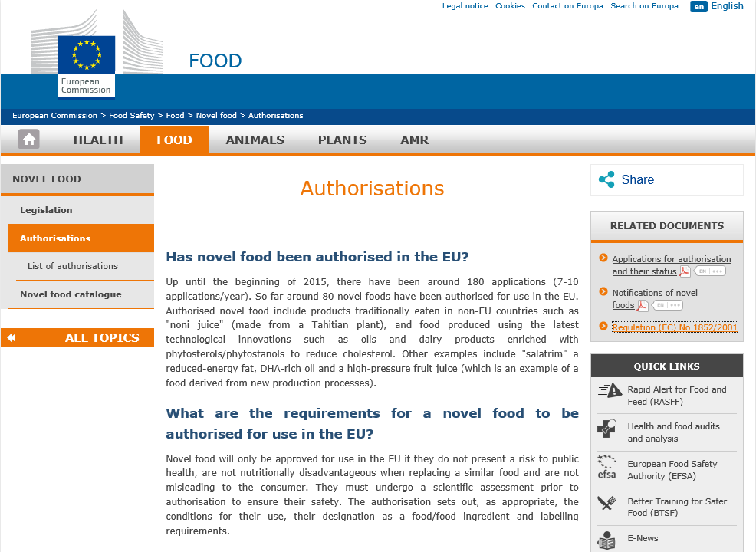
http://ec.europa.eu/food/safety/novel_food/authorisations_en

Slide 37
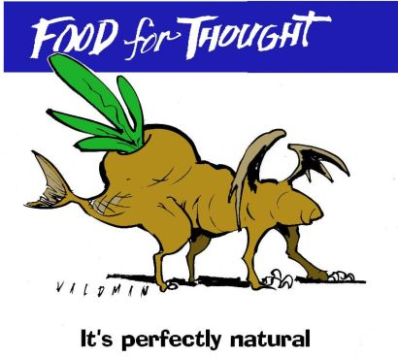
Checklist EU legislation for foodstuffs II. Technical requirements
II.1. Production methods
II.1.3. Novel foods or novel food ingredients, Genetically Modified
Organisms (GMOs)
(Reg. 258/97, Reg. 1829/2003, Reg. 1830/2003, Dir. 2001/18/EC, Reg. 65/2004)
GMOs
Authorization: by European Food Safety Authority (EFSA)
Labelling: = compulsory for all GMO products
Aims: - inform consumers
- ensure that a product is traceable throughout the food chain
“genetically modified” or “produced from genetically modified (name of organism)”
+ industrial operators must inform receivers about unique alphanumerical identifiers (9 characters) assigned to the GMOs contained in the products

Slide 38
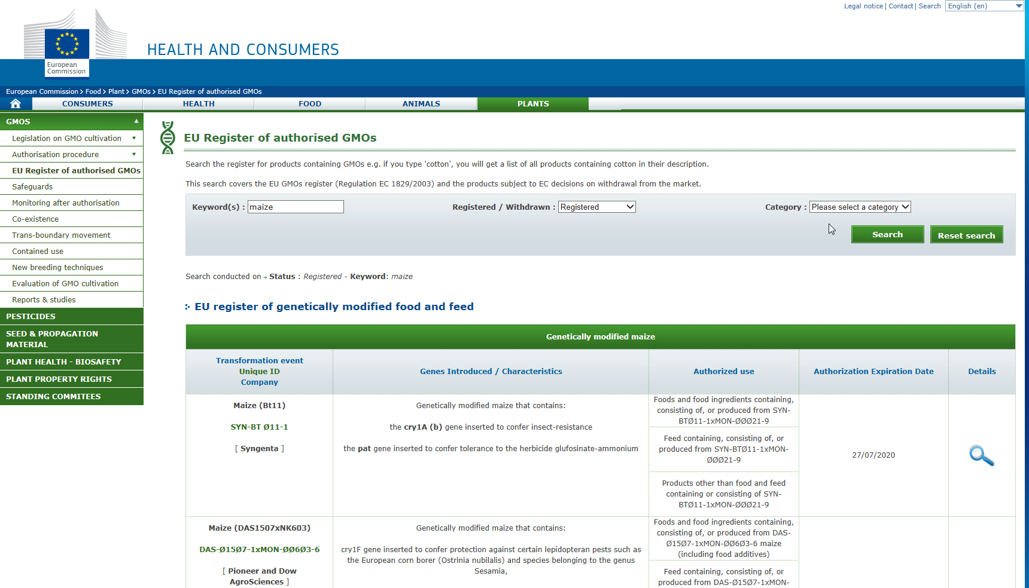
Consult info on authorised GMOs at: http://ec.europa.eu/food/dyna/gm_register/index_en.cfm

Slide 39
Checklist EU legislation for foodstuffs II. Technical requirements
II.2. Foodstuffs for particular purposes or target groups
II.2.1. Foodstuffs for particular nutritional uses (Reg.(EU)609/2013)
II.2.2. Foodstuffs for use in energy-restricted diets for weight reduction
II.2.3. Dietary foods for special medical purposes
II.2.4. Processed cereal-based foods and baby foods for infants and young children
II.2.5. Infant formulae and follow-on formulae
II.2.6. Gluten-free foodstuffs (Reg.(EC) 41/2009) – new Reg. (EU)609/2013)
II.2.7. Food supplements (Dir. 2002/46/EC)
II.2.8. Adding vitamins or minerals to foods (Reg.(EC)1925/2006)

Slide 40
Checklist EU legislation for foodstuffs II. Technical requirements
II.2. Foodstuffs for particular purposes or target groups
II.2.1. Foodstuffs for particular nutritional uses (Reg.(EU) 609/2013)
must be suitable for certain categories of persons:
- those whose digestive processes or metabolism are disturbed;
- those suffering from a particular physiological condition; and
- infants or young children in good health.
Only foodstuffs which meet the nutritional requirements of the two first categories of persons mentioned above may bear the words “dietetic” or “dietary”.
Substances that may be added for specific nutritional purposes in foods for particular nutritional uses
See next slides for specific products within this field.
! New Regulation (EU) 609/2013 applied since 20/7/2016

Slide 41
Checklist EU legislation for foodstuffs II. Technical requirements
II.2. Foodstuffs for particular purposes or target groups
II.2.2. Foods used in energy-restricted diets for weight reduction
(Dir. (EC) 96/8, Reg. (EU) 609/2013)
Products presented as a replacement for one or more meals of the daily diet
(see also future amendments of Reg. (EU)1924/2006 on nutritional claims)
Products presented as a replacement for the whole of the daily diet
Labelling: ‘Total diet replacement for weight control’ or
‘Meal replacement for weight control’
General and specific compositional criteria (See both legal texts, incl. Annex of Reg. 609/2013 + future delegated Acts)

Slide 42
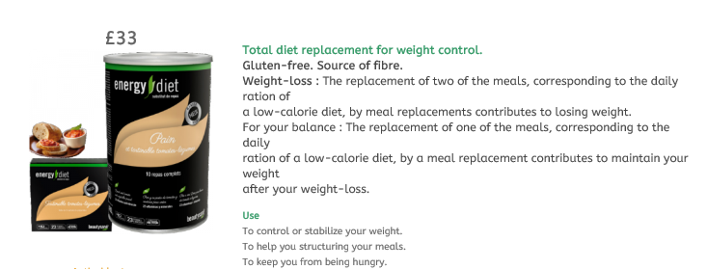
Checklist EU legislation for foodstuffs II. Technical requirements
II.2. Foodstuffs for particular purposes or target groups
II.2.2. Foods used in energy-restricted diets for weight reduction
(Dir. (EC) 96/8, Reg. (EU) 609/2013)
Illustration

Slide 43
Checklist EU legislation for foodstuffs II. Technical requirements
II.2. Foodstuffs for particular purposes or target groups
II.2.3. Dietary foods for special medical purposes
(Dir. 1999/21/EC), Reg. (EU) 609/2013, Reg. (EU) 2016/128)
Compositional and labelling requirements,incl.:
- a statement that the product must be used under medical supervision;
- a statement as to whether the product is suitable for use as the sole source of nourishment;
- where appropriate, a statement that the product is intended for a specific age group;
- where appropriate, a statement that the product poses a health hazard when consumed by persons who do not have the diseases, disorders or medical conditions for which the product is intended;
- Where appropriate, a statement concerning adequate precautions and contra-indications;
- …
+ mandatory particulars mentioned in art. 9(1) of Reg. (EU) 1169/2011
+ specific requirements on the nutrition declaration (in addition to Art. 30(1) of Reg. (EU) 1169/2011)
+ specific requirements for food for special medical purposes developed to satisfy the
nutritional requirements of infants
https://ec.europa.eu/food/safety/labelling_nutrition/special_groups_food/medical_en

Slide 44
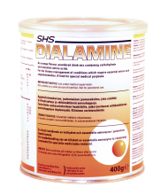
II.2.3. Dietary foods for special medical purposes EXAMPLE
Checklist EU legislation for foodstuffs II. Technical requirements
Description:
Dialamine is a pale orange powder containing 30% essential amino acids, carbohydrate, flavouring and low levels of minerals. Available in orange flavour only. A food for special medical purposes.
Indications & Prescribability:
Dialamine can be used in infants over 6 months, children and adults as an essential amino acid supplement for the dietary management of certain urea cycle disorders such as OTC deficiency and CPS deficiency.
Suggested Intake:
The quantity of Dialamine should be determined by a clinician or dietitian and is dependent on the age, bodyweight and medical condition of the patient.
A source of vitamins, minerals and trace elements may be required.
Preparation & Administration:
The recommended dilution is 1 to 5 (i.e. 20g Dialamine plus 100ml water). Osmotically sensitive patients may require an initial dilution of 1 to 7.
1. Add a small amount of water to the prescribed amount of Dialamine. Stir with a fork until a smooth paste is obtained. 2. Continue stirring whilst adding the remaining volume of water.
Dialamine is now ready for use.
Dialamine is best served as a chilled drink.
The osmolality of Dialamine at 1 to 5 dilution is 900 mosm/kg.
Precautions:
Use under medical supervision. Not suitable for use as a sole source of nutrition. Not for parenteral use.
Storage:
Store in cool, dry place. Always replace the container lid after use. Once opened use within one month.
Pack Size:
200g securitainers.
Notes:
Shelf life: 2 years.

Slide 45
Checklist EU legislation for foodstuffs II. Technical requirements
II.2. Foodstuffs for particular purposes or target groups
II.2.4. Processed cereal-based foods and baby foods for infants and young children (Dir. 2006/125/EC, Reg. (EU) 609/2013) Infant < 12 months, young children < 3 years
Scope: 1) 4 categories of processed cereal-based foods
- simple cereals which are or have to be reconstituted with milk or other appropriate nutritious liquids;
- cereals with an added high protein food which are or have to be reconstituted with water or other protein-free liquid;
- pastas which are to be used after cooking in boiling water or other appropriate liquids;
- rusks and biscuits which are to be used either directly or, after pulverisation, with the addition of water, milk or other suitable liquids.
2) ‘baby foods’ other than processed cereal-based foods
Compositional requirements: only suitable ingredients (supported by scientific data)
Annexes: lists of products and substances (including minerals and vitamins) that can be added to these foods
Labelling: minimum age (> 4 months); presence or absence of gluten if product is for age < 6 months; energy value (in kJ and kCal) and proteins; average quantity of each mineral and vitamin;
Maximum pesticide levels: 0.01 mg.kg (exceptions: Annex VI)

Slide 46
II.2.4. Processed cereal-based foods and baby foods for infants and young children - EXAMPLE
Checklist EU legislation for foodstuffs II. Technical requirements
Heinz Breakfast
Banana Multigrain Cereal
No artificial colours or preservatives
Enriched with vitamins A, B, C, D and Niacin
Contains prebiotics
Low Salt
egg free
Banana Multigrain cereal is a blend of banana with five delicious cereal grains and prebiotics.
Product information correct in July 2009 and this data could be updated at any time. Please refer to product packaging at the time of purchase for accurate information. H.J.Heinz accepts no responsibility for any reliance placed on this data.

Slide 47
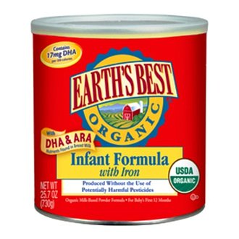
Checklist EU legislation for foodstuffs II. Technical requirements
II.2. Foodstuffs for particular purposes
or target groups
II.2.5. Infant formulae and follow-on formulae
(Dir. 2006/141/EC, Reg. (EU) 609/2013)
Infant = children < 12 months
Very strict rules regarding: composition; maximum pesticide residues; labelling advertising; marketing
e.g.
- manufactured from cows’ or goats’ milk proteins or soya proteins and other food substances (minerals, vitamins, amino acids, etc.) set out in the Annex to the Directive
- the manufacturer or importer of the said formulae shall forward a model of the label used to the
competent authority of the Member State where the product is to be marketed
- labelled with name ‘infant formulae’ or ‘follow-on formulae’ (or ‘infant milk’ or ‘follow-on milk’ in
case the products are entirely produced from cows’ milk proteins)
- pesticide residue level in infant formulae and follow-on formulae is set at 0.01 mg/kg of the
product proposed ready for consumption.
+ comply with rules regarding hygiene, food addtitives and contaminants
(see further in this checklist)
https://ec.europa.eu/food/safety/labelling_nutrition/special_groups_food/children_en

Slide 48
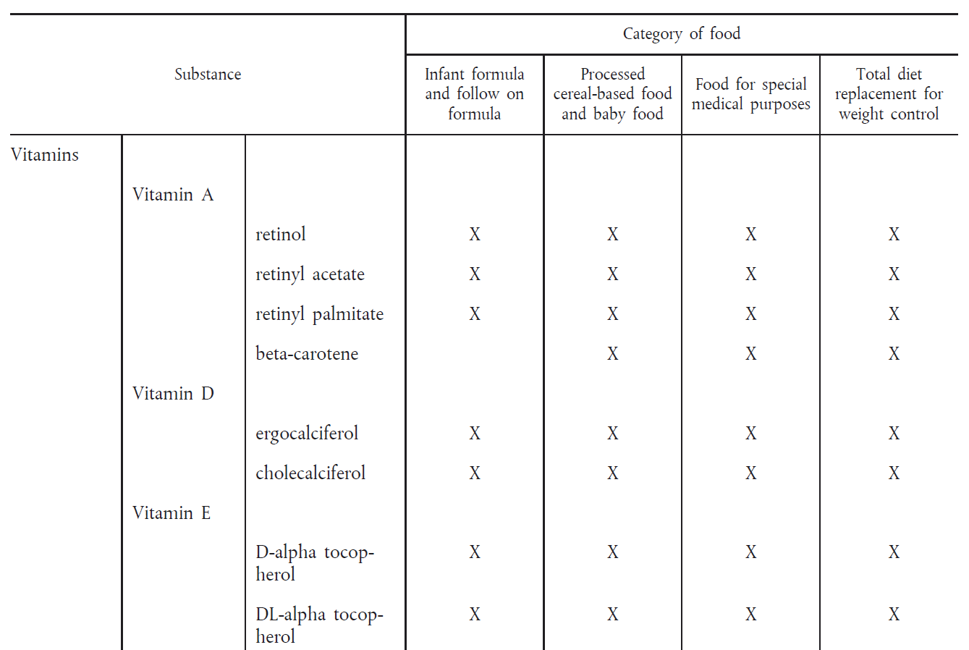

Slide 49
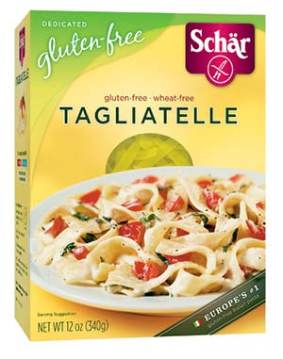
Checklist EU legislation for foodstuffs II. Technical requirements
II.2. Foodstuffs for particular purposes or target groups
II.2.6. Gluten-free foodstuffs (Reg. (EU) 828/2014, Reg. (EC) 609/2013)
Composition and labelling of foodstuffs suitable
for people intolerant to gluten
2 thresholds:
- ‘Gluten-free’ foodstuffs
< 20 mg/kg of gluten in the finished product
- ‘Very low gluten’ foodstuffs
< 100 mg/kg of gluten in the finished product
‘gluten’ means a protein fraction from wheat, rye, barley, oats or their crossbred varieties and derivatives thereof, to which some persons are intolerant and which is insoluble in water and 0,5 M sodium chloride solution
+ see relevant measures under Reg. (EU) 1169/2011
https://ec.europa.eu/food/safety/labelling_nutrition/special_groups_food/gluten_en

Slide 50
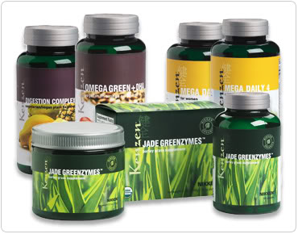
Checklist EU legislation for foodstuffs II. Technical requirements
II.2. Foodstuffs for particular purposes or target groups
II.2.7. Food supplements (Dir. 2002/46/EC)
= concentrated sources of nutrients (vitamins and mineral salts) in dose form (capsules, tablets, sachets, etc.)
Composition: Annex I: authorised vitamins and minerals
Annex II: authorised vitamin and mineral formulations
Labelling must contain: - the term ‘food supplement’
- the category of nutrients in the supplement and/or the name of the nutrients and the quantity of each nutrient
- recommended daily amount + risk warning
- declaration – supplement is not a substitute for a varied diet
- reference ‘This is not a medicinal product’ if presentation of the product is similar to that of a medicinal product
- warning that product should be stored out of the reach of young children
https://ec.europa.eu/food/safety/labelling_nutrition/supplements_en

Slide 51
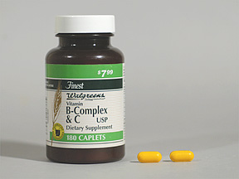
Checklist EU legislation for foodstuffs II. Technical requirements
II.2. Foodstuffs for particular purposes or target groups
II.2.8. Addition of vitamins and minerals to foods (Reg. (EC) 1925/2006)
Annexes: list of (sources of) vitamins, minerals and certain other substances such as fibre,
essential fatty acids, etc. wich may be added to foods voluntarily.
Nutrition labelling: - total amount of added vitamins and minerals
- amount of protein, carbohydrate, sugars, fat, saturates, fibre and sodium - energy value of the product
(see Nutrion value declaration – Reg. (EU) 1169/2011)
Maximum levels of vitamins and minerals that can
be added to foods.
Vitamins and minerals may not be added to unprocessed fruit,
vegetables, meat, poultry and fish, beverages > 1.2 % by vol. of alcohol (!exceptions)
Community Register: see link below
https://ec.europa.eu/food/safety/labelling_nutrition/vitamins_minerals_en

Slide 52
Checklist EU legislation for foodstuffs II. Technical requirements
II.3. Additives, flavourings, food enzymes & extraction solvents
II.3.1. Additives
II.3.2. Flavourings
II.3.3. Food enzymes
II.3.3. Extraction solvents

Slide 53
Checklist EU legislation for foodstuffs II. Technical requirements
II.3. Additives, flavourings, food enzymes &
extraction solvents
II.3.1. Additives (Reg.(EC)1333/2008, Reg.(EC)1331/2008)
Reg. (EC) 1333/2008
Annex I: Functional classes (sweeteners, colours, preservatives, antioxidants, carriers, acids, acidity regulators, anti-caking agents, anti-foaming agents, bulking agents, etc.) 27 classes
Annex II: Authorised additives for use in foods + conditions of use
Annex III: List of food additives for use in other additives, flavours and in food enzymes, as well as their conditions of use
+ labelling rules
Reg. (EC) 1331/2008
Risk assessment + common authorisation procedure for food additives, enzymes and flavourings
https://ec.europa.eu/food/safety/food_improvement_agents/additives_en

Slide 54
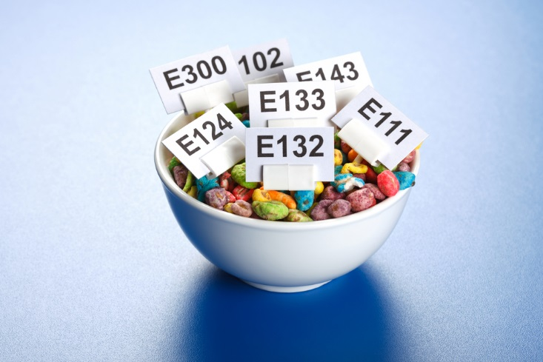
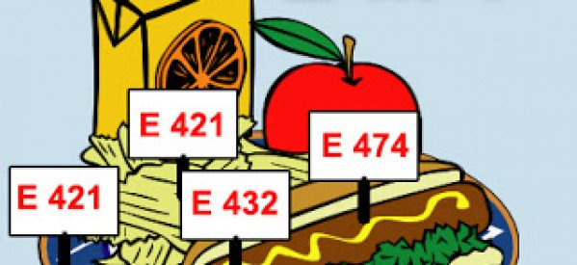
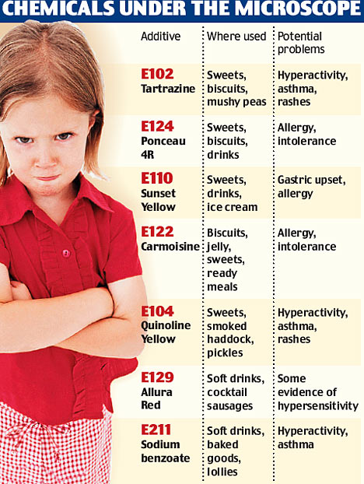
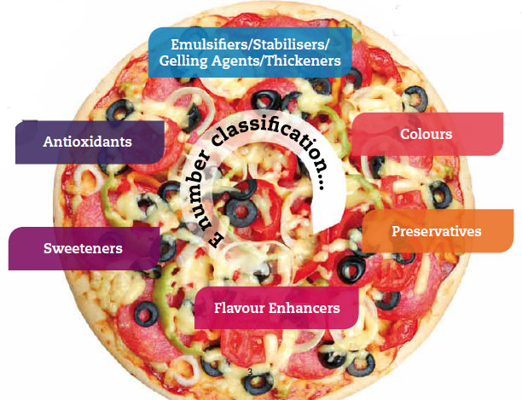

Slide 55
https://webgate.ec.europa.eu/foods_system/main/?event=display

Slide 56
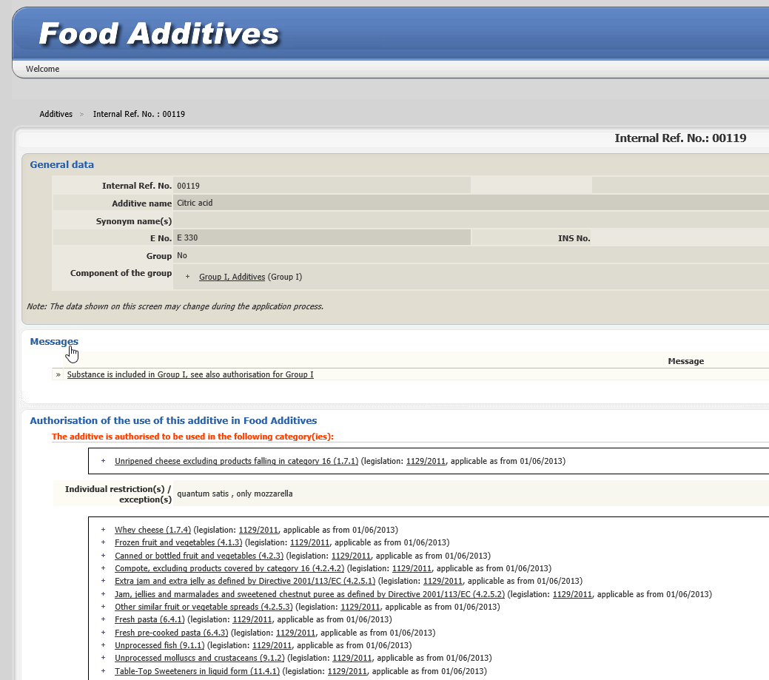
Example: is it allowed to use citric acid in fresh pre-cooked pasta?

Slide 57
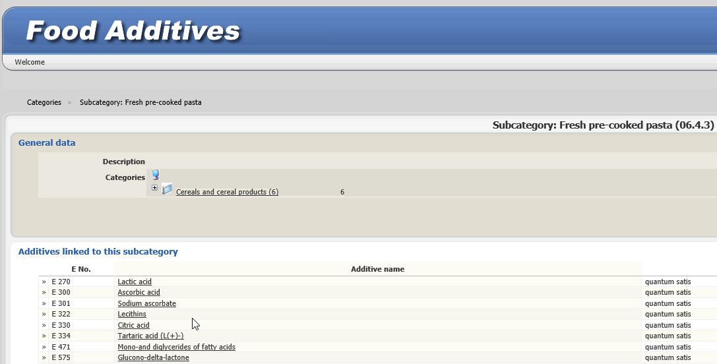
The specification of quantum satis for an ingredient essentially means "Add as much of this ingredient as is needed to achieve the desired result, but not more."

Slide 58
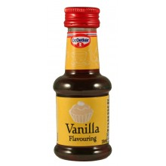
Checklist EU legislation for foodstuffs II. Technical requirements
II.3. Additives, flavourings, food enzymes &
extraction solvents
II.3.2. Flavourings
(Reg.(EC)1334/2008, Reg.(EC)1331/2008 + Reg.(EC) 872/2012)
Aim = to impart odour and/or taste to food
Community list of flavourings and source materials approved for use in and on foods
(see next slide)
Labelling: ‘flavouring’ or a more specific name or description of the flavouring
‘for food’ or ‘restricted use in food’ or a more specific reference to its intended food use
‘natural flavouring’ or any equivalent term if the flavouring is obtained directly from a substance or preparation found in animal or plant material
https://ec.europa.eu/food/safety/food_improvement_agents/flavourings_en

Slide 59
https://webgate.ec.europa.eu/sanco_foods/main/?sector=FFL

Slide 63
Checklist EU legislation for foodstuffs II. Technical requirements
II.3. Additives, flavourings, food enzymes &
extraction solvents
II.3.3. Food enzymes (Reg.(EC)1332/2008, Reg.(EC)1331/2008)
= the rules on food enzymes used in foods, including such enzymes used as processing aids
Community list of authorised food enzymes (not yet approved, MS’ legislation applies)
Labelling:
the name of the food enzyme or the accepted name laid down in the nomenclature of the International Union of Biochemistry and Molecular Biology (IUBMB);
the statement ‘for food’ or the statement ‘restricted use in food’ or a more specific reference to its intended food use
+ additional labelling elements for products in B2B (not for final consumer)

Slide 64
http://ec.europa.eu/food/safety/food_improvement_agents/enzymes_en

Slide 65
Checklist EU legislation for foodstuffs II. Technical requirements
II.3. Additives, flavourings, food enzymes &
extraction solvents
II.3.4. Extraction solvents (Dir. 2009/32/EC)
Extraction solvent =
a solvent which is used in an extraction procedure during the processing of raw materials, of foodstuffs, or of components or ingredients of these products and which is removed but which may result in the unintentional, but technically unavoidable, presence of residues in the foodstuff or food ingredient.
Annex I: Extraction solvents to be used in compliance with GMP for all uses
(e.g. propane, butane, carbon dioxide, acetone, etc.)
Extraction solvents for which conditions of use are specified, incl.
maximum levels of residue limits
Rules for determining purity criteria
http://ec.europa.eu/food/safety/food_improvement_agents/extraction-solvents_en

Slide 66
Checklist EU legislation for foodstuffs II. Technical requirements
II.4. Production of specific foodstuffs
II.4.1. Fats, meats
II.4.2. Milk derivatives
II.4.3. Sugars, honey
II.4.4. Beverages
II.4.5. Coffee and chicory extracts

Slide 67
Checklist EU legislation for foodstuffs II. Technical requirements
II.4. Production of specific foodstuffs
II.4.1. Fats, meats
II.4.1.1. Edible oils or fats (Reg.(EU) 696/2014, Reg.(EU) 2015/705)
Scope = - oils, fats and blends intended for human consumption
- foodstuffs with a fat content of 5% or more
Level of erucic acid in edible oils and fats <= 5 % of total level of fatty acids in the fat component
= protection from possible toxic effects of ingesting the acid
Erucic acid = a fatty acid that has been associated with heart disease. It is present in rapeseed oil that is used in some countries as a vegetable oil for salad dressings, margarines, and mayonnaise. Canola oil is a rapeseed oil from which virtually all erucic acid has been removed through breeding.
http://ec.europa.eu/food/safety/chemical_safety/contaminants/catalogue/plant_toxins_en

Slide 69
Checklist EU legislation for foodstuffs II. Technical requirements
II.4. Production of specific foodstuffs
II.4.1. Fats, meats
II.4.1.2. Beef or beef products (Reg.(EC)1760/2000 + Reg. (EC) 1825/2000)
Regulation (EC) 1760/2000 establishes:
a cattle identification and registration system (Title I);
a compulsory labelling system (Title II, Section I) and a voluntary labelling system (Title II, Section II) for beef and veal.

Slide 70
Compulsary labelling of origin !

Slide 71
Checklist EU legislation for foodstuffs II. Technical requirements
II.4. Production of specific foodstuffs
II.4.2. Milk derivatives
II.4.2.1. Edible caseins and caseinates (lactoproteins)
(Dir. (EU) 2015/2203, Dir. 85/503/EEC, Dir. 86/424/EEC)
Harmonisation of composition and manufacturing characteristics of certain edible lactoproteins (standards: see Annexes I and II)
Specific labelling rules, incl.:
name of the milk product (or mixture);
Net quantity in kg or g;
Name of producer or importer in EU;
name of the country of origin (for products imported from a third country);
lot identification or date of production;

Slide 72
Checklist EU legislation for foodstuffs II. Technical requirements
II.4. Production of specific foodstuffs
II.4.2. Milk derivatives
II.4.2.2. Partly or wholy dehydrated preserved milk
(Dir. 2001/114/EC, Dir. 79/1067/EEC, Dir. 87/524/EEC)
Annexes: products concerned (different types of preserved milk)
e.g. types of condensed milk and milk powder
Labelling: trade name +
% of fat (by weight in relation to the finished products) +
% of fat-free dried milk extract

Slide 73
Checklist EU legislation for foodstuffs II. Technical requirements
II.4. Production of specific foodstuffs
II.4.3. Sugars, honey
II.4.3.1. Cocoa and chocolate (Dir. 2000/36/EC)
Composition of: - cocoa butter
- cocoa and powdered chocolate, including reduced-fat or non-fat
- chocolate, milk chocolate – including family chocolate, white chocolate, filled chocolate, ‘chocolate a la taza’ and chocolates or pralines, etc.
(min. % of cocoa butter, cocoa powder, etc.)
Authorization of <= 5 % of vegetable fat other than cocoa butter
(e.g. palm oil, ilepe, copra oil, shea, mango kernels, etc;)
Labelling: sales names (e.g. ‘cocoa powder’, ‘chocolate’, etc.) can only be used if products meet compositional rules

Slide 74
Checklist EU legislation for foodstuffs II. Technical requirements
II.4. Production of specific foodstuffs
II.4.3. Sugars, honey
II.4.3.2. Honey (Dir. 2001/110/EC)
General definition of honey (Annex I) and
Composition criteria (Annex II)
Labelling: - country of origin of the honey as well as the blend
- names and definitions of filtered honey and bakers’ honey
Composition: “Honey” should not contain any added food ingrediënts
or additives.
! Health certificate

Slide 75
Checklist EU legislation for foodstuffs II. Technical requirements
II.4. Production of specific foodstuffs
II.4.3. Sugars, honey
II.4.3.3. Fruit jams, jellies, marmalades and sweetened chestnut
purée (Dir. 2001/113/EC)
Composition: - lists and definitions of raw materials which may be used
- fruit and sugar content
- authorised additives
- maximum sulphur dioxide content
+ labelling rules

Slide 76
Checklist EU legislation for foodstuffs II. Technical requirements
II.4. Production of specific foodstuffs
II.4.3. Sugars, honey
II.4.3.4. Sugars (Dir. 2001/111/EC)
Definition of 11 varieties of sugar : semi-white sugar, sugar (white sugar), extra white sugar, sugar solution, invert sugar solution, invert sugar syrup, glucose syrup, dried glucose syrup, dextrose monohydrate, dextrose or dextrose anhydrous and fructose.
+ rules on manufacturing characteristics
+ packaging and labelling rules

Slide 77
Checklist EU legislation for foodstuffs II. Technical requirements
II.4. Production of specific foodstuffs
II.4.4. Beverages
II.4.4.1. Natural mineral waters (Dir. 2009/54/EC, 2003/40/EC)
Scope:
This Directive concerns waters extracted from the ground of a Member State and recognised by the responsible authority of that Member State as natural mineral waters satisfying the provisions of Annex I, Section I.
This Directive also concerns waters extracted from the ground of a third country, imported into the Community and recognised as natural mineral waters by the responsible authority of a Member State.
Member States communicate a list of recognized mineral waters to the European Commission. (= published at the Official Journal).

Slide 78
Checklist EU legislation for foodstuffs II. Technical requirements
II.4. Production of specific foodstuffs
II.4.4. Beverages
II.4.4.1. Natural mineral waters (Dir. 2009/54/EC, Dir. 2003/40/EC)
- Treatments: only treatments mentioned in the Directive are permitted
- Criteria for microbiological analyses at source: see Annex I
- Conditions for exploitation and marketing of natural mineral water: Annex II
- Criteria for indications (e.g. ‘low mineral content’, ‘rich in mineral salts’): Annex III
- Labelling and packaging: requirements of Dir. 2000/13 +
the statement of analytical composition;
the name of the spring and the place of exploitation;
information on any treatments

Slide 79
http://ec.europa.eu/food/safety/labelling_nutrition/mineral_waters_en

Slide 80
Checklist EU legislation for foodstuffs II. Technical requirements
II.4. Production of specific foodstuffs
II.4.4. Beverages
II.4.4.2. Drinking water (Dir. 1998/83/EC)
Healthiness and purity requirements for water intended for human consumption apart from natural mineral waters and waters which are medicinal products:
not contain any concentration of micro-organisms, parasites or any other substance which constitutes a potential human health risk;
meets the minimum requirements (microbiological and chemical parameters and those relating to radioactivity) laid down by the Directive.
Methods of analysis to be applied by Member States at regular monitoring of the quality of drinking water.

Slide 81
http://ec.europa.eu/environment/water/water-drink/legislation_en.html

Slide 82
Checklist EU legislation for foodstuffs II. Technical requirements
II.4. Production of specific foodstuffs
II.4.4. Beverages
II.4.4.2. Fruit juices and similar products (Dir. 2001/112/EC)
Products covered are: - fruit juice;
- fruit juice from concentrate;
- dehydrated / powdered fruit juice;
- water extracted fruit juice;
- fruit nectar.
Labelling should indicate when a product is a mixture of fruit juice and fruit juice from concentrate, and for fruit nectar, when it has been obtained entirely or partly from a concentrated product.
(the product name shall be composed of a list of the fruits used, in descending order of the volume of the fruit juices or purées included, as indicated in the list of ingredients)
The addition of sugars is no longer authorised in fruit juices.
Member States may authorise the addition of vitamins and minerals to fruit juice, fruit juice from concentrate, concentrated fruit juice, dehydrated/powdered fruit juice, fruit nectar.

Slide 83
Checklist EU legislation for foodstuffs II. Technical requirements
II.4. Production of specific foodstuffs
II.4.5. Coffee and chicory extracts (Dir. 99/4/EC)
Composition: minimum requirements, in particular as regards the coffee-based or chicory-based dry matter component
(as a % by weight of the finished product)
Labelling: only descriptions coffee extract, chicory extract, soluble coffee extract, soluble chicory, instant chicory and soluble or instant coffee may be used.
+ ‘paste’ or ‘in paste form’, ‘liquid’ or ‘in liquid form’, ‘concentrated’ etc. and any added substances
+ the cafeine content
+ minimum coffee-based (chicory-based) dry matter content
(% of weight)

Slide 84
Checklist EU legislation for foodstuffs II. Technical requirements
II.5. Hygiene of foodstuffs & other health aspects
II.5.1. Hygiene of foodstuffs - general rules
II.5.1.1. General principles of food law – EFSA – Procedures for food safety
II.5.1.2. Hygiene of foodstuffs
II.5.1.3. Official food and feed controls
II.5.2. Foodstuffs with ingredients of animal origin
II.5.2.1. Specific hygiene rules for food of animal origin
II.5.2.2. Official controls on products of animal origin
II.5.2.3. Animal health rules for production, processing, distribution and
introduction of products of animal origin
http://ec.europa.eu/food/safety/biosafety/food_hygiene_en

Slide 85
Checklist EU legislation for foodstuffs II. Technical requirements
II.5. Hygiene of foodstuffs & other health aspects
II.5.1. Hygiene package (HACCP!)
Reg. 178/2002: General hygiene principles and requirements, incl. traceability and (II.5.1.1.) withdrawal of products (= procedures in matters of food safety)
Reg. 852/2004: Annex I – general hygiene provisions for food business operators
(II.5.1.2.) Annex II – hygiene requirements for food premises, transport conditions, equipment, food waste, water supply, personal hygiene of persons in contact with food, food, wrapping and packaging, heat treatment, training of food workers (= activities other than primary production)
+ HACCP system
(Guides to good practice and to the application of HACCP)
Reg. 882/2004: Official food and feed controls
(II.5.1.3.)

Slide 86
Rules to be respected by food business operators in third countries (Articles 3 to 6 of Reg. (EC) No. 852/2004)
A general obligation on the operator to monitor the food safety of products and processes under his responsibility (Art. 3 of Reg. (EC) No. 852/2004)
General hygiene provisions for primary production (Art. 4.1. of, and Part A of Annex I to Reg. (EC) No. 852/2004)
Detailed requirements after primary production (Art. 4.2. of and Annex II to Reg. (EC) No. 852/2004)
For certain products, microbiological requirements (Art. 4.3. of Reg. (EC) No. 852/2004) and Commission Reg. (EC) No. 2073/2005 on microbiological criteria for foodstuffs
Procedures based on the HACCP principles (Art. 5 of Reg. (EC) No. 852/2004
Registration or approval of establishments (Art. 6 of Reg. (EC) No. 852/2004

Slide 87
Reg. (EC) 852/2004 Detailed provisons in Annexes

Slide 88
Reg. (EC) 852/2004
Need to have HACCP system

Slide 90
Consult available guides for the application of HACCP principles in various food sectors(see Part 2)

Slide 92
HACCP
Example of Flow Diagram: Ready-to-Eat Fresh-Cut Vegetables

Slide 93
Reg. (EC) 852/2004
How to comply with hygiene rules for farms? Use standards such as GlobalGAP (next slides)

Slide 94
GlobalGAP as a worldwide recognized standard for safe agricultural products
http://www.globalgap.org/uk_en/what-we-do/

Slide 95
Voluntary standards / certifications such as GlobalGAP offer a technical answer to legal EU requirements regarding hygiene of agricultural products and…are often demanded by importers in the EU who are buying from third countries

Slide 102
Example: the company SGS is one of the many approved certification bodies for GLOBALGAP

Slide 103
ISO 22000: a voluntary but important food safety standard
The ISO 22000 family of international standards addresses food safety management. They help companies identify and control food safety hazards. The ISO 22000 family contains a number of standards each focusing on different aspects of food safety management. ISO 22000:2005 contains the overall guidelines for food safety managementSO ISO 22004:2014 provides generic advice on the application of ISO 22000 ISO 22005:2007 focuses on traceability in the feed and food chain ISO/TS 22002-1:2009 contains specific prerequisites for food manufacturing ISO/TS 22002-2:2013 contains specific prerequisites for catering ISO/TS 22002-3:2011 contains specific prerequisites for farming ISO/TS 22002-4:2013 contains specific prerequisites for food packaging manufacturing ISO/TS 22003:2013 provides guidelines for audit and certification bodies More info: http://www.iso.org/iso/home/standards/management-standards/iso22000.htm

Slide 104
ISO 22000:2005 specifies requirements for a food safety management system where an organization in the food chain needs to demonstrate its ability to control food safety hazards in order to ensure that food is safe at the time of human consumption.
It is applicable to all organizations, regardless of size, which are involved in any aspect of the food chain and want to implement systems that consistently provide safe products. The means of meeting any requirements of ISO 22000:2005 can be accomplished through the use of internal and/or external resources.
ISO 22000:2005 specifies requirements to enable an organization
- to plan, implement, operate, maintain and update a food safety management system aimed at providing products that, according to their intended use, are safe for the consumer,
- to demonstrate compliance with applicable statutory and regulatory food safety requirements,
- to evaluate and assess customer requirements and demonstrate conformity with those mutually agreed customer requirements that relate to food safety, in order to enhance customer satisfaction,
- to effectively communicate food safety issues to their suppliers, customers and relevant interested parties in the food chain,
- to ensure that the organization conforms to its stated food safety policy,
- to demonstrate such conformity to relevant interested parties, and
- to seek certification or registration of its food safety management system by an external organization, or make a self-assessment or self-declaration of conformity to ISO 22000:2005.

Slide 106
Checklist EU legislation for foodstuffs II. Technical requirements
II.5. Hygiene of foodstuffs & other health aspects II.5.1. Hygiene package (HACCP!)
Traceability
Some food producers are barcoding their food so that when it’s scanned by a smart phone the consumer can see where it’s from, if it’s been recalled.

Slide 107
Checklist EU legislation for foodstuffs II. Technical requirements
II.5. Hygiene of foodstuffs & other health aspects
II.5.2. Foodstuffs with ingredients of animal origin
II.5.2.1. Specific hygiene rules for food of animal origin
Reg. 853/2004: specific hygiene rules for food of animal origin
(II.5.2.1.) - Approval of establishments
- Health marking and identification (oval mark with name of producing country and the establishment’s approval number)
- Specific rules for different categories of products:
meat of domestic ungulates; meat of poultry and lagomorphs; meat of farmed game; wild game meat; minced meat, meat preparations and mechanically separated/recovered meat; meat products; fishery products; milk and milk products; eggs and egg products; frog’s legs and snails, rendered animal fats and greaves; treated stomachs, bladders and intestines; gelatine, collagen.
Reg. 854/2004: official controls on products of animal origin
(II.5.2.2.)
Dir. 2002/99/EC: - veterinary certificates and checks
(II.5.2.3.) - conditions for non-EU countries to get on list of authorised countries / regions
www.east-invest2.eu

Slide 108
Import procedures for food of animal origin
Products of animal origin must be presented at an EU approved border inspection post (BIP) for being submitted to an import control / veterinary checks;
Prior notification of the physical arrival of the products on the EU territory must be provided to the BIP of arrival using the Common Veterinary Entry Document (CVED);
The consignments must be presented to the BIP accompanied by all relevant certificates/documents required in EU legislation;
Consignments will only be accepted if the products are derived from approved third countries, regions thereof and establishments as appropriate and if veterinary checks had favourable results;
In certain cases, safeguard measures introducing special import conditions or restrictions may apply;
The procedures as laid down in Reg. (EC) No 136/2004 are to be followed

Slide 109
Food of animal origin Obligations of importers (Art. 6 of Reg. (EC) No. 853/2004)
Products come from a third country or a part of a third country that appears on an EU list;
Where applicable, come from an establishment that appears on an EU list;
Where applicable, carry a health or identification mark;
Where applicable, are accompanied by a certificate issued by the representative of the competent authority of the third country;
Are made available for control in an EU approved border inspection post;
Comply with the animal health requirements of Dir. 2002/99/EC;
Operations carried out under their control that take place after importation = in accordance with appropriate requirements of Reg. (EC) No. 853/2004.

Slide 110
http://eur-lex.europa.eu/legal-content/EN/TXT/?uri=celex:32016R0759

Slide 112
http://ec.europa.eu/food/animals/vet-border-control/index_en.htm

Slide 116
Imports of composite products
Composite products =
Products containing both products of plant origin and processed products of animal origin
Examples: ice cream, pizza, ready-to-eat meals, mayonnaise

Slide 118
Food of animal origin
Non-exhaustive list of non-processed food of animal origin
Fresh meat (meat of domestic ungulates, poultry meat, meat from lagomorphs, wild game meat, farmed game meat and other meat);
Minced meat
Meat preparations
Mechanically separated meat
Blood
Fish and crustaceans (incl. live fish and crustaceans)
Live bivalve molluscs, live echinoderms, live tunicates and live marine gastropods
Raw milk
Eggs
Froggs’ legs
Snails
Honey
Other
A non-processed food of animal origin associated with a product of plant origin remains a non-processed product of animal origin e.g.
skewer containing fresh meat and vegetables
Preparations of fresh fishery products (e.g. fish fillets) with food of plant origin

Slide 119
Food of animal origin
Non-exhaustive list of processed food products of animal origin
Processed products are obtained by submitting raw material of animal origin to a process such as heating, smoking, curing, salting, maturing, drying, marinating, etc.
- Meat products (ham, salami) - Fish products (smoked fish, marinated fish)
- Milk products (heat treated milk, cheese, yoghurt) - Egg products
- Rendered animal fat - Greaves
- Gelatine - Collagen
- Treated stomachs and bladders etc.
Processed products also include:
- Combinations of processed products e.g. cheese with ham
- Products obtained after further processing of already processed products
Products to give special characteristics may be added e.g.
- Sausage with garlic
- Yoghurt with fruit
- Cheese with herbs
- Ice cream with chocolate

Slide 120
Imports of composite products
Composite products must satisfy the specific requirements for products of animal origin.
For some composite products certification requirements have to be met. (Reg. (EU) No. 28/2012)
Composite products (CP) = prepared in a registered establishment (exception = processing of unprocessed primary animal product, e.g. fish fillets, which must take place in an approved establishment)
Products of animal origin used for production of CP = originate from an approved establishment

Slide 122
Difference between a processed animal product containing plant material and a composite product Some processed animal products contain plant material. A processed product of animal origin may contain plant material and not be a composite product if the plant material is required as part of the manufacturing process of the product of animal origin or is there to give specific characteristics to the product of animal origin. Specific characteristics could include adding sweetness or flavour, acting as a thickening agent or being present for decoration or as a topping. For example, tuna in vegetable oil or tomato sauce would be regarded as a processed fishery product and not a composite product. This is because the vegetable oil or tomato sauce is necessary as part of the manufacturing process of the canned tuna, (the can needs to be filled with liquid before processing), also because it imparts specific characteristics, in particular taste and consistency. Guidance documents from the European Commission + examples: see following slides. A processed animal product has different import requirements to a composite product.

Slide 123
Determining whether a composite product is subject to veterinary checks As a general rule all food that contains a product of animal origin is covered by veterinary checks unless it is specifically excluded. Composite products may be exempt from veterinary checks if they meet all the requirements of Article 6 of Commission Decision 2007/275/EC; or if they are listed in Annex II to the Decision (Annex II to Commission Decision 2007/275).

Slide 124
Determining whether a composite product is subject to veterinary checks
Article 4 of Dec. 2007/275/EC
Products subject to veterinary checks at BIPs:
Composite products containing processed meat products;
Composite products containing >= 50 % of their substance of any one processed product of animal origin other than processed meat products, e.g. processed fishery products (>=50 %), processed egg products (>=50 %);
Composite products containing no processed meat product & <= 50 % of their substance of processed dairy product where the final products do not meet the requirements of Art. 6. (e.g. CP is not shelf stable)

Slide 125
Determining whether a composite product is subject to veterinary checks
Exempt composite products - Article 6 of Dec. 2007/275/EC
If a composite product meets all of the criteria below it is exempt from veterinary checks:
There are no visible pieces of meat product (not containing any meat products)
The total animal origin content is less than 50% by weight
The product is shelf stable at ambient temperature or has clearly undergone during its manufacture a complete cooking or heat treatment process throughout its substance, so that any raw product is denatured
The composite product is clearly identified as intended for human consumption
The composite product is securely packaged or sealed in clean containers
The composite product is accompanied by a commercial document and labelled in an official language of a Member State, so that the document and labelling together give information on the nature, quantity, number of packages, country of origin and manufacturer of the composite product and its ingredients.

Slide 126
Determining whether a composite product is subject to veterinary checks
Note - Refrigerated composite products
The final composite product must clearly have been cooked or heat-treated sufficiently to denature (physically change) the animal-origin components after the animal product and the plant material have been combined together. Milder heat-treatments such as pasteurization will not denature the animal origin component.
If it is not clear from visual examination that the animal-origin content has been denatured, proof such as a flowchart from the producer showing the cooking process with times and core temperatures, will be required.

Slide 127
Determining whether a composite product is subject to veterinary checks
Exempt products listed in Annex II of Dec. 2007/275/EC
Products exempt from veterinary checks:
Biscuits
Bread
Cakes - this means sponge cake, fruit cake etc. (see note below)
Chocolate
Confectionery (including sweets)
Food supplements packaged for the final consumer, containing small amounts of animal product, and those including glucosamine, chondroitin, or chitosan (pure fish oil in capsules is not exempt)
Olives stuffed with fish
Pasta and noodles not mixed or filled with meat product.
Soup stocks and flavourings packaged for the final consumer, containing meat extracts, meat concentrates, animal fats, or fish oils, powders or extracts.

Slide 129
Note
If an animal product e.g. cream is added after the cake has been baked, the final product may then no longer be exempt from veterinary checks. The intention behind exempting biscuits, bread, cake, confectionery etc. is that the baking process is sufficient to control any animal or public health risk. If animal products are added after baking, the composite product will need to be re-assessed to determine whether or not it is subject to veterinary checks.

Slide 130
Origin of animal-origin ingredients in composite products
Even in a composite product not subject to checks, all animal-origin ingredients must come either from the EU or from non-EU countries which are approved to supply the animal-origin product itself to the EU.
This means that each animal origin ingredient must be sourced from a non-EU country which is both on the relevant third country list published by the Commission and has an approved residue plan for the animal origin ingredient concerned.
From 2017 the animal origin ingredient must also come from an EU approved establishment. The list of countries with approved residue control plan can be found in Commission Implementing Decision 2015/1338

Slide 131
Import requirements for composite products subject to veterinary checks
If you are importing a composite product which is subject to veterinary checks the requirements of Regulation 28/2012 apply.
Health Certificate
The health certificate laid down in Regulation 468/2012 is required if the composite product contains:
processed meat
any processed dairy products and requires refrigeration
50% or more dairy content if shelf stable
50% or more processed fishery products
50% or more processed egg products
If the product contains 50% or more of any other animal product e.g. gelatine, honey, collagen then the EU health certificate that applies to the pure product is required.
Processed animal product content not mentioned above does not have to be certified (although it can be) but must still meet the general requirements to come from an approved establishment in an approved third country with an approved residue control plan.

Slide 132
Import requirements for composite products subject to veterinary checks
Ingredients
Regulation 28/2012 requires that the animal-origin ingredients must originate in the same country that manufactured the composite product.
Exceptions: the Regulation allows countries with low animal health risk to manufacture composite products using meat products or dairy products from other low-risk third countries or from the EU.
The principles are:
A low risk country can use meat products or dairy products from other low risk countries including the EU
A low risk country cannot use meat products or dairy products from a high risk country
A high risk country cannot use meat products or dairy products from other countries but can use meat products or dairy products from the EU

Slide 133
I import ice cream confectionery made with milk powder and vegetable oil. Is this a composite product? Is it subject to veterinary checks? It is a composite product. It is subject to veterinary checks. As the final composite product requires refrigeration, to be exempt from veterinary checks the final composite product must have been cooked or undergone a heat-treatment sufficient to denature the milk powder. This is not possible for ice cream confectionery. Pasteurisation of the final mix would not be sufficient to denature the animal-origin constituents.

Slide 134
Can you give me some examples of composite products which are subject to veterinary checks?
Meat pie (containing cooked meat)
Canned tuna salad (contains tuna combined with vegetables
to make a salad)
Chicken curry (pieces of cooked chicken combined with
vegetables in a sauce)
Prawn spring roll containing 50%+ cooked prawn
Pizza containing uncooked pasteurised cheese, (because
it requires refrigeration, and the final product not cooked)
Gateau with a layer of pasteurised cream (because requires
refrigeration and final product with cream in
place has not been cooked).

Slide 135
Can you give me some examples of composite products which are not subject to veterinary checks?
Fully cooked pizza with less than 50% cheese and no meat
Fully cooked prawn spring roll with less than 50% prawn
Mayonnaise with less than 50% pasteurised egg content

Slide 136
Can you give me some examples of foodstuffs containing plant material which are not composite products but are processed animal products containing plant material?
Uncooked meat pie containing raw meat (not a composite product because meat is raw)
Breaded raw prawns (not a composite product because prawns are raw)
Honey with nuts (not a composite product because honey is raw)
Canned tuna in oil (plant material essential for manufacture)
Cooked tuna fillets in a chilli marinade (marinade adds specific characteristics - flavour, texture - to the tuna)
Cooked breaded prawns (breading gives specific characteristics to prawns; applies regardless of % prawn)
Surimi/ crabsticks (a small amount of plant product is sometimes added to give specific characteristics to the fish content)
Breaded cooked haddock (breading gives specific characteristics - texture - to fish)
Battered chicken nuggets (batter gives specific characteristics - flavour, texture - to the chicken)
Corned beef containing glucose or small amounts of onions (glucose/onions give specific characteristics to corned beef)
Strawberry yoghurt (strawberries give specific characteristics - flavour, texture - to the yoghurt)
Milk dessert with a fruit topping (fruit topping adds specific characteristics - flavour, texture - to the milk dessert)
Battered cooked cheese e.g. 'paneer poppers' (batter gives specific characteristics - texture - to the cheese; applies regardless of % cheese)
Fish sauce with 10% fishery product content, other ingredients are sugar and water. This is a fishery product (no relevant plant material to make it a composite product). Subject to vet checks as a fishery product - the 50% rule applies only to composite products
Yogurt drink like Yakult containing water, 2% skimmed milk powder and sugar. This is a dairy product. There is no relevant plant material to make it a composite product
Gulab Jamun, Rasgulla and similar canned products from India. These consist of cottage cheese balls (@5%) in syrup in a can. These are dairy products (no relevant plant material) and cannot be imported from India.

Slide 137
http://ec.europa.eu/food/safety/biosafety/food_hygiene/guidance/index_en.htm

Slide 138
Composite product or PPOAO (processed product of animal origin)?

Slide 159
Checklist EU legislation for foodstuffs II. Technical requirements
II.6. Food contaminants
II.6.1. Maximum levels for certain contaminants
(Reg.(EC) 315/93, Reg.(EC) 1881/2006)
Contaminants are substances that have not been intentionally added to food. These substances may be present in food as a result of the various stages of its production, packaging, transport or holding. They also might result from environmental contamination.
Maximum quantities for:
mycotoxins (aflatoxins, ochratoxin A, fusarium toxins, patulin and citrinin),
metals (lead, cadmium, mercury, inorganic tin),
3-monochloropropane-1,2-diol (3-MCPD),
dioxins and dioxin-type polychlorinated biphenyls (PCBs),
polycyclic aromatic hydrocarbons (PAHs),
melamine,
erucic acid,
nitrates.

Slide 160
http://ec.europa.eu/food/safety/chemical_safety/contaminants/legislation_en

Slide 161
Checklist EU legislation for foodstuffs II. Technical requirements
II.6. Food contaminants
II.6.2. Maximum residue levels (MRLs)
1) Maximum residue levels of pesticides in or on food and feed of plant and animal origin (Reg.(EC) 396/2005)
All foodstuffs but in particular fruit and vegetables, cereals, tea, coffee, herbal infusions and cacao, hops, spices, sugar plants, foodstuffs of animal origin and honey.
MRL = 0.01 mg/kg by default
(in all cases where an MRL has not been specifically set for a product or product type
2) Maximum residue levels of veterinary medicinal products
(Reg. (EU) 37/2010, Reg.(EC) 470/2009)
The European Medicines Agency issues an opinion.

Slide 162
Consult legal info on MRLs for pesticides via: http://ec.europa.eu/food/plant/pesticides/max_residue_levels/eu_rules_en.htm

Slide 164
Consult MRLs on veterinary medicines on:
http://www.ema.europa.eu/ema/index.jsp?curl=pages/regulation/document_listing/document_listing_000165.jsp

Slide 166
Checklist EU legislation for foodstuffs III. Labelling requirements
III.1. General labelling requirements
III.2. Specific labelling rules for certain foodstuffs
III.3. Labelling rules related to specific indications
www.east-invest2.eu

Slide 167
Checklist EU legislation for foodstuffs III. Labelling requirements
III.1. General labelling requirements
III.1.1. General EU rules about labelling, presentation
and advertising of foodstuffs
III.1.2. Identification of foodstufs by lot
III.1.3. Nutrition values
III.1.4. Nutrition or health claims

Slide 168
http://ec.europa.eu/food/safety_en

Slide 169
Checklist EU legislation for foodstuffs III. Labelling requirements
III.1. General labelling requirements
III.1.1. General EU rules about labelling, presentation and advertising of foodstuffs - Reg.(EC) 1169/2011 replaced Dir. 2000/13/EC and Dir. 2008/5/EC
Compulsory labelling particulars:
- name under which the product is sold;
- list of ingredients and quantity of certain ingredients or categories of ingredients expressed as a percentage;
- substances causing allergies or intolerances (nuts, milk, mustard, fish, grains containing gluten, etc.);
- net quantity;
- date of minimum durability or “use by” date;
- any special storage conditions and/or conditions of use;
- the name or business name and address of the food business operator or importer;
- the country of origin or place of provenance for certain types of meat, milk or where failure to indicate this might mislead the consumer;
- instructions for use where it would be difficult to make appropriate use of the food in the absence of such instructions;
- for beverages containing more than 1.2 % by volume of alcohol, the actual alcoholic strength by volume;
- a nutritional declaration.
www.east-invest2.eu

Slide 170
Illustration: some elements from the text of Reg. (EU) 1169/2011
Reg. 1169 (EU) 2011
Article 13
Presentation of mandatory particulars
1. Without prejudice to the national measures adopted under Article 44(2), mandatory food information shall be marked in a conspicuous place in such a way as to be easily visible, clearly legible and, where appropriate, indelible. It shall not in any way be hidden, obscured, detracted from or interrupted by any other written or pictorial matter or any other intervening material.
2. Without prejudice to specific Union provisions applicable to particular foods, when appearing on the package or on the label attached thereto, the mandatory particulars listed in Article 9(1) shall be printed on the package or on the label in such a way as to ensure clear legibility, in characters using a font size where the x-height, as defined in Annex IV, is equal to or greater than 1,2 mm.
3. In case of packaging or containers the largest surface of which has an area of less than 80 cm², the x-height of the font size referred to in paragraph 2 shall be equal to or greater than 0,9 mm.
4. For the purpose of achieving the objectives of this Regulation, the Commission shall, by means of delegated acts in accordance with Article 51, establish rules for legibility.
For the same purpose as referred to in the first subparagraph, the Commission may, by means of delegated acts in accordance with Article 51, extend the requirements under paragraph 5 of this Article to additional mandatory particulars for specific types or categories of foods.
5. The particulars listed in points (a), (e) and (k) of Article 9(1) shall appear in the same field of vision.

Slide 171
Reg. 1169 (EU) 2011
Article 15
Language requirements
1. Without prejudice to Article 9(3), mandatory food information shall appear in a language easily understood by the consumers of the Member States where a food is marketed.
2. Within their own territory, the Member States in which a food is marketed may stipulate that the particulars shall be given in one or more languages from among the official languages of the Union.
3. Paragraphs 1 and 2 shall not preclude the particulars from being indicated in several languages.
Illustration: some elements from the text of Reg. (EU) 1169/2013
www.east-invest2.eu

Slide 172
Illustration: some elements from the text of Reg. (EU) 1169/2013
Article 21
Labelling of certain substances or products causing allergies or intolerances
1. Without prejudice to the rules adopted under Article 44(2), the particulars referred to in point (c) of Article 9(1) shall meet the following requirements:
(a) they shall be indicated in the list of ingredients in accordance with the rules laid down in Article 18(1), with a clear reference to the name of the substance or product as listed in Annex II; and
(b) the name of the substance or product as listed in Annex II shall be emphasised through a typeset that clearly distinguishes it from the rest of the list of ingredients, for example by means of the font, style or background colour.
In the absence of a list of ingredients, the indication of the particulars referred to in point (c) of Article 9(1) shall comprise the word ‘contains’ followed by the name of the substance or product as listed in Annex II.
Where several ingredients or processing aids of a food originate from a single substance or product listed in Annex II, the labelling shall make it clear for each ingredient or processing aid concerned.
The indication of the particulars referred to in point (c) of Article 9(1) shall not be required in cases where the name of the food clearly refers to the substance or product concerned.
2. In order to ensure better information for consumers and to take account of the most recent scientific progress and technical knowledge, the Commission shall systematically re-examine and, where necessary, update the list in Annex II by means of delegated acts, in accordance with Article 51. Where, in the case of the emergence of a risk to consumers’ health, imperative grounds of urgency so require, the procedure provided for in Article 52 shall apply to delegated acts adopted pursuant to this Article.
www.east-invest2.eu

Slide 174
Checklist EU legislation for foodstuffs III. Labelling requirements
Compulsary labelling particulars:
Name of product
List of ingredients
!!New legislation demands
to highlight allergens
(see correct example in next
slide)
Net quantity
Date of minimum durability

Slide 175
Labelling in all official languages.
Example: three languages for Belgium (Dutch, French, German)
Allergens are highlighted. Example: milk, soja, gluten, egg

Slide 176
Checklist EU legislation for foodstuffs III. Labelling requirements
III.1. General labelling requirements
III.1.2. Identification of prepacked foodstuffs by lot (Dir. 2011/91/EC)
Subject = indications or marks identifying the lot to which a foodstuff belongs
Lot = a batch of sales units of a foodstuff produced, manufactured or packaged under identical conditions
The lot indicated on the packaging or container is determined by the producer, manufacturer or packager of the foodstuff in question, or the first seller within the Community.
Labelling of lot: “L” + indication
It is not necessary to indicate the lot if the date of minimum durability or "use by" date
(indicating the day, month and year) appears on the label.

Slide 177
Checklist EU legislation for foodstuffs III. Labelling requirements
III.1. General labelling requirements
III.1.3. Nutrition labelling (Reg. (EU)1169/2011)
Mandatory nutrition declaration needs to include:
energy value in kilojoules (kJ) or kilocalories (kcal)
amounts of fat, saturates, carbohydrate, sugars, protein & salt in grams (g) or milligrams (mg)
This can be supplemented with an indication of the amounts of:
mono-unsaturates
polyunsaturates
polyols
starch
fibre
vitamins (listed in point 1 of Part A of Annex XIII)
Expression per 100 g or 100 ml

Slide 179
Checklist EU legislation for foodstuffs III. Labelling requirements
Nutrition labelling: example
Average nutritional value
Per 100 g
Energy 2374 kJ
570 kcal
Fat 38.1 g
- of which saturated fatty
acids 23.2 g
Carbohydrate 50.0 g
- of which sugars 49.1 g
Protein 6.7 g
Salt 0.2 g

Slide 180
Which information and logos – related to EU foodstuffs legislation - do you recognize at this image (and the images on the next slides)?

Slide 184
Do you recognize the allergens in the list with ingredients?

Slide 186
Checklist EU legislation for foodstuffs III. Labelling requirements
III.1. General labelling requirements
III.1.4. Nutrition and health claims (Reg. (EC)1924/2006)
www.east-invest2.eu

Slide 187
Checklist EU legislation for foodstuffs III. Labelling requirements
III.1. General labelling requirements
III.1.4. Nutrition and health claims (Reg. (EC)1924/2006)
Annex lists various authorised nutritional claims and conditions applying to them, e.g.:
low energy low sugars source of …(vitamin x) and/or … (mineral x)
energy-free sugars-free high… (vitamin x) and/or …(mineral x)
energy-reduced with no added sugars contains (name of the nutrient or other substance)
increased (name of the nutrient)
low-fat low sodium / salt reduced (name of the nutrient)
fat-free very low sodium / salt light / lite
low saturated fat sodium-free or salt-free naturally / natural
saturated fat-free source of omega -3 fatty acids
source of fibre high omega-3 fatty acids
source of protein high fibre high monounsaturated fat
high protein high polyunsaturated fat
high unsaturated fat
http://ec.europa.eu/food/safety/labelling_nutrition/claims_en
www.east-invest2.eu

Slide 188
Checklist EU legislation for foodstuffs III. Labelling requirements
III.1. General labelling requirements
III.1.4. Nutrition and health claims (Reg. (EC)1924/2006)
Each nutritional claim is defined using precise and quantifiable values.
Examples:
SUGARS-FREE
A claim that a food is sugars-free, and any claim likely to have the same meaning for the consumer, may only be made where the product contains no more than 0,5 g of sugars per 100 g or 100 ml.
LOW FAT
A claim that a food is low in fat, and any claim likely to have the same meaning for the consumer, may only be made where the product contains no more than 3 g of fat per 100 g for solids or 1,5 g of fat per 100 ml for liquids (1,8 g of fat per 100 ml for semi-skimmed milk).
Health claims are subject to specific labelling requirements.
www.east-invest2.eu

Slide 189
http://ec.europa.eu/food/safety/labelling_nutrition/claims/health_claims/index_en.htm
Types of health claims

Slide 190
Checklist EU legislation for foodstuffs III. Labelling requirements
III.2. Specific labelling requirements for certain foodstuffs
III.2.1. Alcoholic drinks
III.2.2. Milk or milk products
III.2.3. Foodstuffs or food ingredients containing GMOs
III.2.4. Foodstuffs containing quinine or caffeine

Slide 191
Checklist EU legislation for foodstuffs III. Labelling requirements
III.2. Specific labelling requirements for certain foodstuffs
III.2.1. Alcoholic drinks
1) Labelling of alcoholic beverages (Reg. (EU)1169/2011)
- Definition of alcoholic strength by volume
- Tolerances allowed in respect of the indication of the alcoholic strength by
volume
(e.g. 0.5 % vol. for beers < 5.5 % vol. )
2) Definition, description, presentation and protection of geographical indications of spirit drinks (Reg.(EC) 110/2008)
- Definition, classification and technical requirements of each type of spirit drink (“rum”, “whisky”, “vodka”, etc.) – drinks >15% alc. by volume
Example: minimum alcoholic strength (e.g. 40 % for whisky)
- List of protected geographical indications

Slide 192
Checklist EU legislation for foodstuffs III. Labelling requirements
III.2. Specific labelling requirements for certain foodstuffs
III.2.1. Alcoholic drinks
2) Definition, description, presentation and protection of geographical indications of spirit drinks (Reg.(EC) 110/2008)
List of protected geographical indications - Examples
Whisky / Whyskey
Scotch Whisky United Kingdom (Scotland)
Irish Whiskey/Uisce Beatha Eireannach/Irish Whisky Ireland
Whisky español Spain
…
Wine spirit
Cognac France

Slide 193
Checklist EU legislation for foodstuffs III. Labelling requirements
III.2. Specific labelling requirements for certain foodstuffs
III.2.1. Alcoholic drinks
3) Definition, description and presentation of aromatized
wines, aromatized wine-based drinks and aromatized
wine-product cocktails (Reg.(EU) 251/2014)
- Rules regarding use of water in the preparation
(quality requirements)
- Rules regarding use of ethyl alcohol to dillute or
dissolve addditives
(ethyl alcohol must be of agricultural origin and its use limited
to a strict minimum)

Slide 194
Checklist EU legislation for foodstuffs III. Labelling requirements
III.2. Specific labelling requirements for certain foodstuffs
III.2.1. Alcoholic drinks
4) Labelling of wine and certain other wine sector products (Reg. (EC)607/2009)
Protected designations of origin (PDO) and protected geographical indications (PGI), traditional terms, labelling and presentation of certain wine sector products
Labelling must indicate: - the sales designation of the products
- the nominal volume
- the alcoholic strength by volume (… % vol)
- the lot number
- the presence of sulphites, if any
- other ingredients
Special labelling rules for: - table wines and quality wines
- new wines still in fermentation and grape musts
- traditional terms (protected!)
- imported products
- liqueur wines and sparkling wines,

Slide 195
Checklist EU legislation for foodstuffs III. Labelling requirements
III.2. Specific labelling requirements for certain foodstuffs
III.2.1. Alcoholic drinks
4) Labelling of wine and certain other wine sector products (Reg. (EC)607/2009)
Protected designations of origin and geographical indications,
traditional terms, labelling and presentation of certain
wine sector products (Reg. (EC) 607/2009)
Example: Protected Designation of Origin –
Madeira wine
(In Portuguese: Vinho Madeira)

Slide 196
Checklist EU legislation for foodstuffs III. Labelling requirements
III.2. Specific labelling requirements for certain foodstuffs
III.2.2. Milk or milk products (Reg. (EU)1308/2013)
Definitions and designations in respect of milk and milk products:
- whey - cream
- butter - buttermilk
- butteroil - caseins
- anhydrous milkfat (AMF) - cheese
- yogurt - kephir
- koumiss - viili/fil
- smetana - fil

Slide 197
Checklist EU legislation for foodstuffs III. Labelling requirements
III.2. Specific labelling requirements for certain foodstuffs
III.2.3. Labelling of GM food and feed
(Reg.(EC)1829/2003, Reg.(EC)1830/2003)
A single authorisation procedure for all food and feed
containing GMOs.
Scope: - genetically modified organisms for food and feed use;
- food and feed containing GMOs;
- food and feed produced from or containing ingredients produced from GMOs.
Labelling: food should be labelled as a GMO if the product or its components contains GMOs
"This product contains genetically modified organisms" or "Product produced from GM (name of organism)" must appear on a label affixed to the product + alphanumeric identifier (9 characters)
Exceptions for GMOs <= 0.9 % per ingredient and if the presence of GMOs is adventitious or technically unavoidable
Traceability standards (Reg. 1830/2003)
http://ec.europa.eu/agriculture/gi-international_en

Slide 198
Checklist EU legislation for foodstuffs III. Labelling requirements
III.2. Specific labelling requirements for certain foodstuffs
III.2.4. Labelling of caffeine and quinine (Reg. (EC)1169/2011)
Compulsory = labelling of presence of quinine and caffeine
If caffeine > 150 mg/l: “high caffeine content” on label + quantity specified

Slide 199
Checklist EU legislation for foodstuffs III. Labelling requirements
III.3. Labelling rules related to specific indications
III.3.1. Traditional specialties and geographical indications of origin
III.3.2. Organically grown agricultural products and foodstuffs

Slide 200
Checklist EU legislation for foodstuffs III. Labelling requirements
III.3. Labelling rules related to specific indications
III.3.1. Traditional specialties and geographical indications of origin
1) Agricultural products and foodstuffs as Traditional Specialities Guaranteed (TSGs) (Reg. (EC) 1151/2012)
Example: Pizza Napoletana
The EU’s member states, on 9 December 2009, backed a proposal to register ‘Pizza Napoletana’ as a ‘traditional speciality guaranteed’, under the Union’s quality labelling scheme.

Slide 201
Checklist EU legislation for foodstuffs III. Labelling requirements
III.3. Labelling rules related to specific indications
III.3.1. Traditional specialties and geographical indications of origin
2) Protection of Geographical Indications (PGI) and Designations of Origin (PDO)
(Reg. (EC) 1151/2012)
The two types of geographical description are different. A PDO (Protected Designation of Origin) covers the term used to describe foodstuffs which are produced, processed and prepared in a given geographical area using recognised know-how (such as Mozzarella di Bufala Campana). A PGI (Protected Geographical Indication) indicates a link with the
area in at least one of the stages of production, processing or preparation .
The link with the area is therefore stronger for PDOs.

Slide 202
Checklist EU legislation for foodstuffs III. Labelling requirements
III.3. Labelling rules related to specific indications
III.3.1. Traditional specialties and geographical indications of origin
2) Protection of Geographical Indications (PGI) and Designations of Origin (PDO)
(Reg. (EC) 1151/2012)
Example: Champagne (PDO, France)
Champagne is a sparkling wine produced by inducing the in-bottle secondary fermentation of wine to effect carbonation. It is produced exclusively within the Champagne region of France, from which it takes its name. While the term "champagne" is used by some makers of sparkling wine in other parts of the world, numerous countries limit the use of the term to only those wines that come from the Champagne appellation. In Europe, this principle is enshrined in the European Union by Protected Designation of Origin (PDO) status. Other countries, such as the United States, have recognized the exclusive nature of this name, yet maintain a legal structure that allows longtime domestic producers of sparkling wine to continue to use the term "Champagne" under specific circumstances.

Slide 203
Checklist EU legislation for foodstuffs III. Labelling requirements
III.3. Labelling rules related to specific indications
III.3.1. Traditional specialties and geographical indications of origin
2) Protection of Geographical Indications (PGI) and Designations of Origin (PDO)
(Reg. (EU) 1151/2012)
Example: Tarta de Santiago (PGI, Spain)
Tarta de Santiago is a traditional cake from northern Spain. The tarta is dense and rich in flavor and is well-known in Santiago, Spain as a delectable treat used to lure passers-by into restaurants or cafés.

Slide 204
http://ec.europa.eu/agriculture/gi-international_en
Agreements with Georgia and Moldova

Slide 205
Example of a PGI – Protected Geographical Indication
Protected name:
“Café de Colombia”

Slide 206
The DOOR database includes product names registered as PDO, PGI or TSG as well as names for which registration has been applied. E-BACCHUS is the database on geographical indications protected in the European Community for wines originating in Member States and third countries.

Slide 208
Checklist EU legislation for foodstuffs III. Labelling requirements
III.3. Labelling rules related to specific indications
III.3.2. Organically grown agricultural products and foodstuffs
(Reg. (EC) 834/2007, Reg. (EC) 889/2008, Reg. (EC) 1235/2008)
Rules of production and distribution
Labelling rules
Controls

Slide 210
List with products covered by this Certificate

Slide 211
Indication of the physical location of the company for which this certificate is valid

Slide 212
Checklist EU legislation for foodstuffs IV. Packaging requirements
IV.1. Prepacked products
IV.2. Packaging and packaging waste
IV.3. Food contact materials
www.east-invest2.eu

Slide 213
Checklist EU legislation for foodstuffs IV. Packaging requirements
IV.1. Prepacked products
IV.1.1. Deregulation of pack sizes (Dir. 2007/45/EC)
Regulations prescribing mandatory nominal quantities for prepackaged products are banned.
Some exceptions were allowed till 2012/2013 for milk, butter, dried pasta, coffee and sugar).
Wines and spirits: Annex contains list of nominal quantities of prepackages
www.east-invest2.eu
http://ec.europa.eu/growth/single-market/goods/building-blocks/legal-metrology/pack-sizes_en

Slide 215
Checklist EU legislation for foodstuffs III. Labelling requirements
IV.1. Prepacked products
IV.1.2. Making-up by weight or by volume (Dir. 76/211/EEC)
Prepackages, i.e. packages prepared in advance (from 5g or 5 ml till 10 kg or 10 l), must indicate on the labelling the weight or volume they contain, taking into account the maximum permitted measurement errors.
Use of the EEC mark
Prepacked products may bear the EEC mark if they comply with the requirements set out in the Directive with regard to quality and metrological control (Annex I, section 5 and Annex II).
Label: weight or volume + EEC mark
http://ec.europa.eu/growth/single-market/goods/building-blocks/legal-metrology/pre-packaging_en

Slide 217
Checklist EU legislation for foodstuffs III. Labelling requirements
IV.2. Packaging and packaging waste (Dir. 94/62/EC)
This Directive covers all packaging and packaging waste.
Member States have to take measures to prevent the formation of packaging waste and to develop packaging reuse systems.
MS must introduce systems for the return and/or collection of used packaging to attain certain targets.
Enterprises have to register at national schemes and pay a contribution for the type and quantity of packaging they bring on the market as a producer, importer, etc.
(Example: Green dot system)
https://ec.europa.eu/growth/single-market/european-standards/harmonised-standards/packaging_en

Slide 218
Checklist EU legislation for foodstuffs III. Labelling requirements
IV.2. Packaging and packaging waste (Dir. 94/62/EC)
www.east-invest2.eu

Slide 219
Checklist EU legislation for foodstuffs IV. Packaging requirements
IV.3. Materials and articles intended to come into a
direct contact with foodstuffs
IV.3.1. “Active” and “intelligent” packaging (framework legislation)
IV.3.2. Plastic materials
IV.3.3. Ceramic articles
IV.3.4. Materials and articles made of cellulose film
IV.3.5. Active and intelligent materials and articles
www.east-invest2.eu
www.east-invest2.eu

Slide 220
Checklist EU legislation for foodstuffs IV. Packaging requirements
IV.3. Materials and articles intended to come into a direct contact with foodstuffs
IV.3.1. Food contact materials – framework legislation + GMP
(Reg. (EC) 1935/2004, Reg. (EC) 2023/2006)
17 groups of materials and articles where specific measures may be adopted
(cork, glass, plastic, textiles,…), incl. purity standards, list of substances used
“Empty” packaging, to be used by consumers for storing food, must be marked with the words “for food use” or bear an associated symbol (glass and fork symbol)
Labelling rules for “active” food contact materials
Authorisation for “intelligent” packaging (e.g. provides info on the quality / freshness of the product) and “active” packaging (e.g. preserves it for longer by introducing favourable chemical modifications.
Traceability requirements from production to sale (comparable with similar rules for the foodstuffs themselves).
https://ec.europa.eu/food/safety/chemical_safety/food_contact_materials_en
https://webgate.ec.europa.eu/foods_system/main/?sector=FCM&auth=SANCAS
www.east-invest2.eu

Slide 221
Checklist EU legislation for foodstuffs IV. Packaging requirements
IV.3. Materials and articles intended to come into a direct contact with foodstuffs
IV.3.2. Plastic materials and articles + coatings
(Reg. (EU) 10/2011, Reg. (EC) 282/2008, Dir. 82/711/EEC,
Reg. (EC) 1895/2005, Dir. 78/142/EEC, Dir. 93/11/EEC)
Positive list with approved substances (e.g. monomers, additives) with specific conditions of use and maximum limits of migration to foodstuffs
(in mg/kg or mg/dm2)
Overall Migration Limits and Specific Migration Limits (SMLs)
Declaration of compliance (by manufacturer)
Additional rules for recycled plastic materials and articles + vinyl chloride monomer + epoxy derivatives + elastomer or rubber (teats and soothers)
www.east-invest2.eu

Slide 222
Checklist EU legislation for foodstuffs IV. Packaging requirements
IV.3. Materials and articles intended to come into a direct contact with foodstuffs
IV.3.3. Ceramic objects (Dir. 84/500/EC)
Ceramics can transfer toxins (lead and cadmium) to foodstuffs.
If products are intended to come into contact with foodstuffs:
written declaration from the manufacturer or seller stating that they do not
exceed the maximum limits for the transfer of lead and cadmium.

Slide 223
Checklist EU legislation for foodstuffs IV. Packaging requirements
IV.3. Materials and articles intended to come into a direct contact with foodstuffs
IV.3.4. Regenerated cellulose film (Dir. 2007/42/EC)
= a film obtained from refined cellulose derived from wood or cotton that have not been recycled. Appropriate substances can be added to the body or surface of the material for technological reasons.
Types: - uncoated
- with coating derived from cellulose
- with coating consisting of plastics
Annex II: list of substances that can be used + conditions of use
Printed side: must not be allowed to come into contact with foodstuffs

Slide 224
Checklist EU legislation for foodstuffs IV. Packaging requirements
IV.3. Materials and articles intended to come into a direct contact with foodstuffs
IV.3.5. Active and intelligent materials and articles (Reg. (EC) 450/2009)
Active food contact materials absorb or release substances in order to improve the quality of packaged food or to extend its shelf life.
Intelligent food contact materials monitor the condition of packaged food or the surrounding environment, for instance by providing information on the freshness of the food.
Requirements
Composition (Community list of authorised substances)
Labelling
https://www.efsa.europa.eu/en/topics/topic/active_intelligent_packaging

Slide 225
Summary of legal topics and standards to be verified when doing business with the EU (and/or be confronted with certain DCFTA implications)
Exporters of fresh products must comply with the following requirements | Exporters of processed products must comply with the following requirements
Guarantee that products comply with food safety requirements (e.g. via GlobalGAP certificate) | Guarantee levels of food safety by implementing HACCP procedures (e.g. via ISO 22000)
Apply systems and procedures that permit traceability (e.g. via GlobalGAP certificate) | Apply systems and procedures that permit the traceability of ingredients and food products
Assure that the products meet all EU phytosanitary requirements | Comply with all labelling requirements
Be sure that the products comply with the maximum permissible pesticide residue limits (MRLs) allowed in food | Comply with the general directives regarding material and objects that may enter in contact with food.
Comply with marketing norms | Comply with rules related to food additives
 | Comply with rules related to food contaminants
Identify the existence of import quotas that could affect the importation of a product
Identify the taxes that need to be paid at the time of importation
Be sure that all wood packaging complies with International Standards for Phytosanitary Measures No. 15 (ISPM 15)
Register a trade mark if there is an interest in selling a product under the own brand
Comply with the requirements for organic products if the products will be sold under this denomination

Slide 226
Part 2. Websites with useful info on selling foodstuffs in the EU
1) European Commission – Export Helpdesk (import duties / formalities)
http://exporthelp.europa.eu/thdapp/index.htm
How to use this website?
Select ‘My export’ and search info on:
- Requirements
- Tariffs
- Preferential arrangements
- Statistics
See also next slides.

Slide 238
Search info on plant health documents needed for import in EU

Slide 239
Consult info on plant health certificates

Slide 240
Find here info on marketing standards for fish

Slide 241
Consult full tekst at website !

Slide 242
Preferential import tariff for jams is 0 %
Preferential tariff for jams is 0 %

Slide 243
Read here rules of origin for jams

Slide 245
Part 2. Websites with useful info on selling foodstuffs in the EU
2) European Commission – TARIC (import duties / formalities)
http://ec.europa.eu/taxation_customs/dds2/taric/taric_consultation.jsp?Lang=en
How to use this website?
Find info on import tariffs and related measures
See next slides for an example.

Slide 248
Part 2. Websites with useful info on selling foodstuffs in the EU
3) European Commission – Eur-Lex (full texts of EU legislation)
http://eur-lex.europa.eu/en/index.htm
How to use this website?
Step 1: Try to find titles and reference numbers of EU laws via the
‘Export Helpdesk’ website of DG Trade or the ‘Food Safety’ web page
(see next slides). Example: search Regulation (EU) 1169/2011.
Step 2: Login to the website of Eur-Lex.
Step 3: Enter in the box ‘year’ ‘2011’ and in the box ‘number’ ‘1169’, select ‘Regulation’ and click on .
Step 5: Click on the most recent consolidated version of the Regulation.
Step 6: Read or download the selected document (in the language of your choice)

Slide 249
Type here the year and the number of the document that you are looking for (and select “Regulation” or “Directive”)

Slide 250
Consult a summary or full text of this law (e.g. Regulation about labelling of foodstuffs)
!Recommendation: consult the most recent consolidated version

Slide 251
The summary of this EU law is presented in the following slides.

Slide 255
Part 2. Websites with useful info on selling foodstuffs in the EU
4) European Commission – Food Safety Web page
http://ec.europa.eu/food/safety/index_en.htm
This website contains a detailed description of topics regulated under EU foodstuffs and animal feed laws (e.g. comments, guidelines, specific databases with info on regulated topics, information about new legislation under preparation, contact points, etc).

Slide 256
Example: consult here info on rules regarding food contact materials
(= packaging for foodstuffs)

Slide 257
This database contains practical info about approved Food Contact Materials (e.g. plastics)

Slide 258
Part 2. Websites with useful info on selling foodstuffs in the EU
4) European Commission – Food Safety Web page
http://ec.europa.eu/food/food/index_en.htm
Official Controls TRACES
TR@CES makes access to the European market easier for non-EU countries by providing the latest versions of the required health certificates in all official EU languages.
Non-EU countries wanting to export products to the EU more easily can join TR@CES. Economic operators must contact their country's competent authorities for authorisation to export and join the lists of approved establishments.
If you are a business operator, please apply for registration as a TR@CES user to the veterinary authorities in your country (the TR@CES administrators for the country).
Once registered, you can issue veterinary certificates for your products.

Slide 259
Part 2. Websites with useful info on selling foodstuffs in the EU
4) European Commission – Food Safety Web page
http://ec.europa.eu/food/food/index_en.htm
Official Controls TRACES
Certification chain – non-EU consignments coming to the EU
Consignors (exporters) can create a certificate for export to the EU by filling in part I. The competent authority at the place of origin validates or rejects part II.
Each stage triggers a notification to all those involved (in the example of second next slide the border inspection post has triggered the notification).
NB: once the border inspection post completes its part of the process, the "IMPORT" certificate is "cloned" into a CVED (common veterinary entry document) to continue its journey in the EU. For goods subject to prior approval of establishments, there is a coherence check.

Slide 260
http://ec.europa.eu/food/animals/traces/index_en.htm

Slide 261
Websites with practical info on selling foodstuffs in the EU
4) European Commission – Food Safety Web page
http://ec.europa.eu/food/food/index_en.htm
Official Controls TRACES

Slide 262
Part 2. Websites with useful info on selling foodstuffs in the EU
4) European Commission – Food Safety Web page
http://ec.europa.eu/food/safety/international_affairs/trade/index_en.htm
International Affairs - Import Conditions
The European Commission works to ensure that Europe's food supply is the safest in the world and that the same standards of food safety apply to all products regardless of origin. As the world's biggest importer and exporter of foodstuffs, the European Union works closely with international organisations and offers advice as well as assistance to third country trading partners.
On the next slides: various web pages that are useful for food exporters in countries outside of the EU

Slide 264
Consult here a list of e.g. companies in Ukraine producing foodstuffs with animal ingredients which are allowed to export to the EU

Slide 265
No lists yet with approved establishments (companies)
in Georgia !

Slide 271
Part 2. Websites with useful info on selling foodstuffs in the EU
4) European Commission – Codex Alimentarius
http://www.codexalimentarius.net/web/index_en.jsp
Consult at this website info on: - HACCP
- Food standards

Slide 272
Part 2. Websites with useful info on selling foodstuffs in the EU
5) European Commission – Codex Alimentarius
http://www.fao.org/fao-who-codexalimentarius/en/
Useful publication: Food Hygiene – Basic texts (4th edition)
ftp://ftp.fao.org/codex/Publications/Booklets/Hygiene/FoodHygiene_2009e.pdf
Page 23-33: - Principles of the HACCP system
- Guidelines for the application of HACCP
- Logic sequence for application of HACCP (12 steps)
- Decision tree to identify CCP (example)
- HACCP worksheet (example)

Slide 277
Consult here technical standards (= best practices) for producing certain foodstuffs

Slide 278
Part 2. Websites with useful info on selling foodstuffs in the EU
5) European Commission – TAIEX
http://ec.europa.eu/enlargement/tenders/taiex/index_en.htm
TAIEX is the Technical Assistance and Information Exchange instrument of the European Commission. TAIEX supports public administrations with regard to the approximation, application and enforcement of EU legislation as well as facilitating the sharing of EU best practices.

Slide 280
CCVista database contains translations of EU laws in various languages of non-EU countries

Slide 281
Useful information sources (summary)
I. European import rules and product legislation
Import taxes and specific import / product requirements: http://exporthelp.europa.eu/thdapp/index.htm
Summaries and full texts of EU foodstiffs laws: http://eur-lex.europa.eu/en/index.htm
II. EU policy in the field of food and feed safety
Food safety: http://ec.europa.eu/food/food/index_en.htm
EU rules on pesticide MRLs: http://ec.europa.eu/food/plant/pesticides/max_residue_levels/eu_rules_en.htm
III. HACCP – food hygiene standards:
Codex Alimentarius (WHO / FAO): http://www.codexalimentarius.org/
IV. Specific labels for foodstuffs:
PGI, PDO, TSG: http://ec.europa.eu/agriculture/quality/schemes/logos/index_en.htm
http://ec.europa.eu/agriculture/quality/door/list.htm
Organic production: http://ec.europa.eu/agriculture/organic/index_en.htm
V. Nutrition and health claims: http://ec.europa.eu/nuhclaims/
VI. Packaging and packaging waste
PRO – Europe: http://www.pro-e.org/
VII. Financing via DCFTA – SME Facility and related support programs
EIB: http://www.eib.org
EBRD: http://www.ebrd.com
Neighbourhood Investment Facility: https://ec.europa.eu/europeaid/regions/eu-neighbourhood-region-and-russia/interregional-cooperation/neighbourhood-investment_en
www.east-invest2.eu

Slide 282
Thank you for your attention! Questions?
Luc Van Looveren
Senior Advisor EU – relations
Voka – Chamber of Commerce and Industry Antwerp-Waasland
Luc.vanlooveren@voka.be
www.east-invest2.eu

